Slide 1

Place Value & Calculations
Year 2 Maths Workshop
Thursday 1st October 2020

Slide 2
Aims of the workshop
Inform of the Year 2 Maths National Curriculum for 2020-21.
Discuss resources used in school.
Teach methods for calculations (addition, subtraction, multiplication and division).
Look at the development from concrete – pictorial – abstract learning and calculating.
Online Learning Resources for home use.

Slide 3
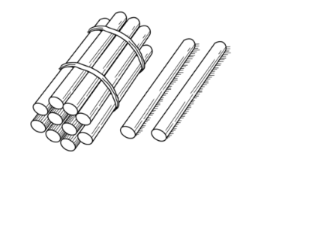
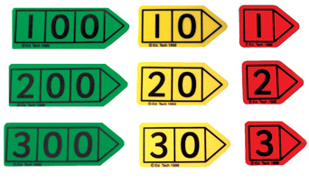
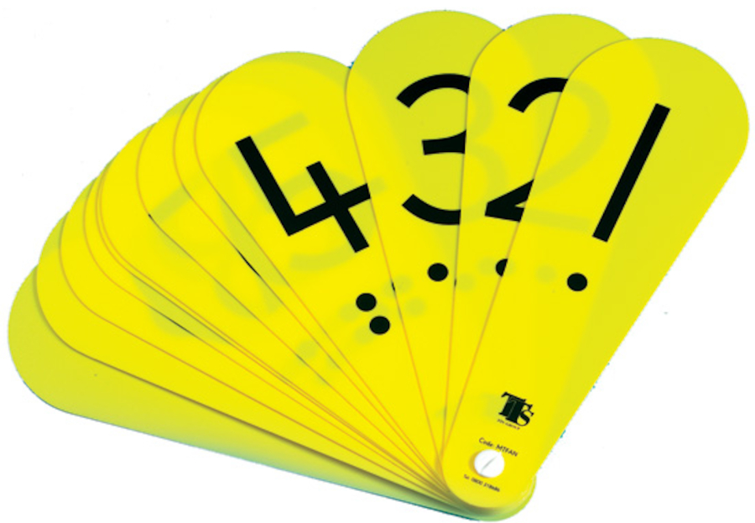
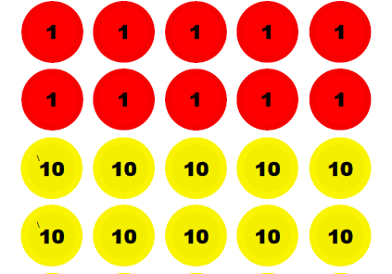
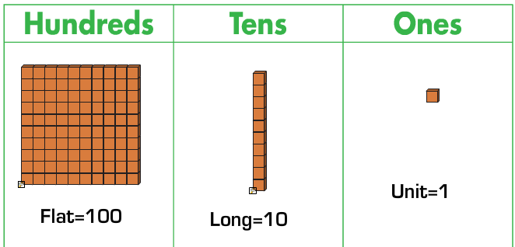
Resources used
Arrow Cards
Straws (10 Bundles
And single 1s)
Number Fans
Place Value Counters
Base 10

Slide 5
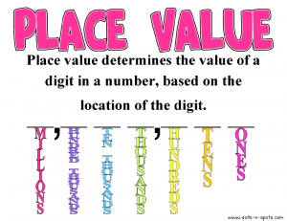

Slide 6
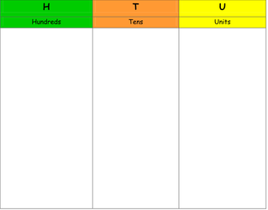
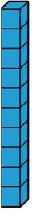

Concrete (Using base 10)

Slide 7
Concrete (Using base 10)
5
6

Slide 8
Have a go challenge!
Can you make the number 37 with base 10

Slide 9
Pictorial (Using base 10)
56 = 5 tens 6 ones

Slide 10
Abstract (Partitioning)
56 = 50 + 6

Slide 11
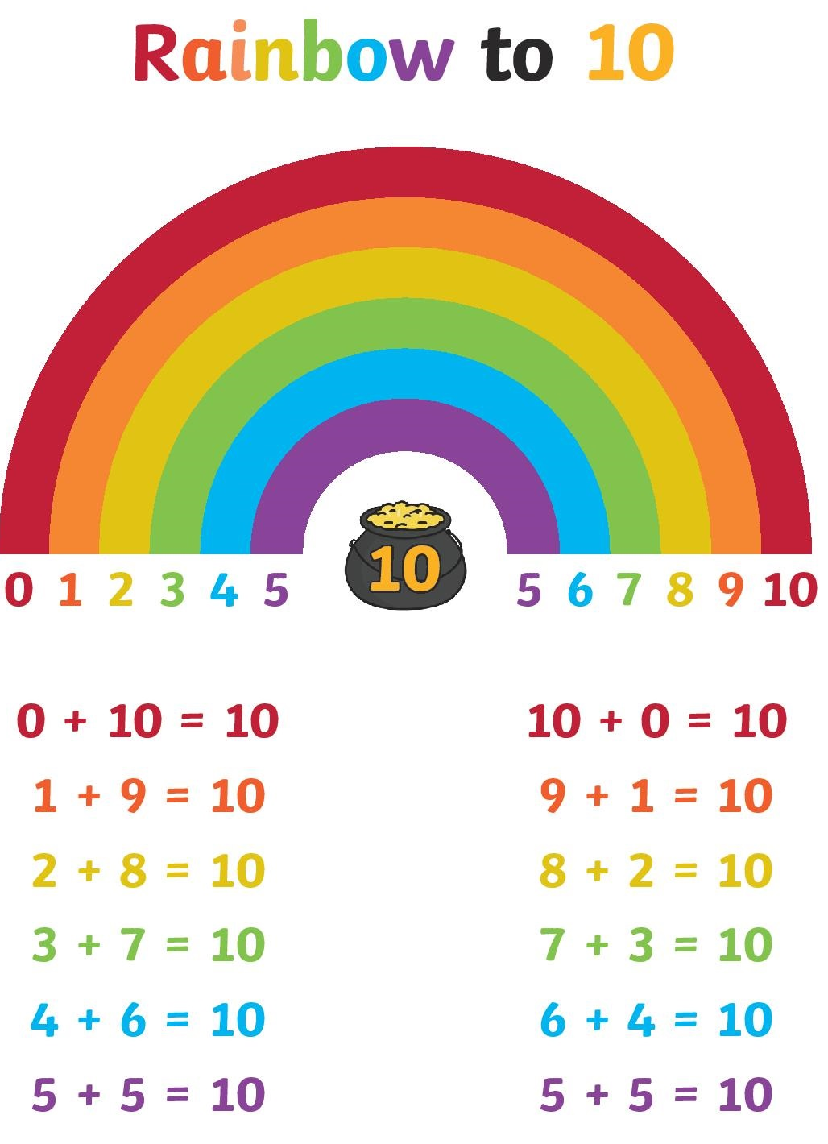
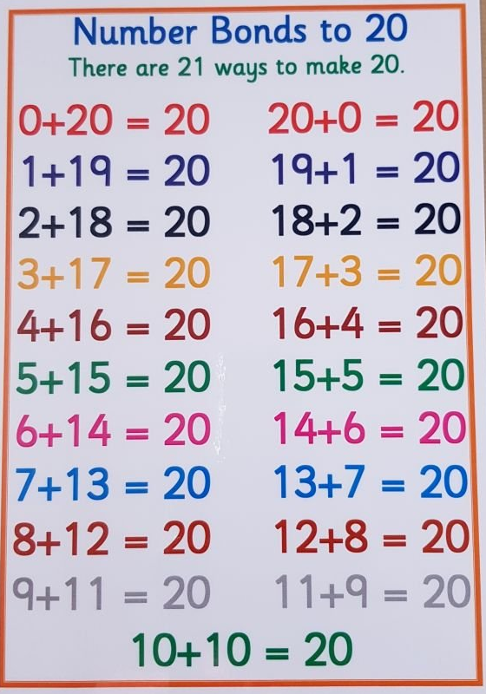
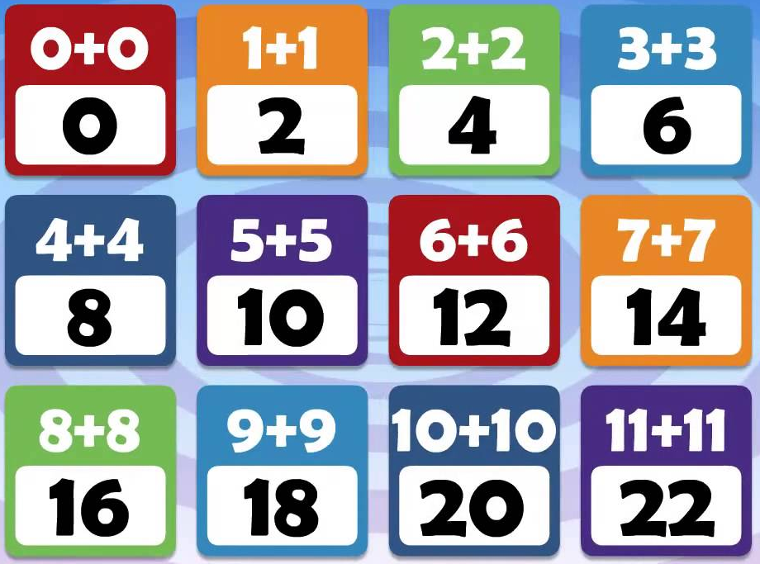
Number Facts (Mental recall)
Counting up to and through 100.
10 more and 10 less than a given number.
1 more and 1 less than a given number.
Number Bonds to 10 – related facts to 100.
Number Bonds to 20.
Doubles to 20- subsequent halves.

Slide 13
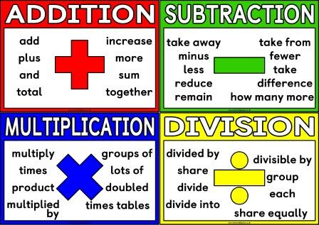

Slide 14
Concrete (Using the straws)
24 + 12 =

Slide 15
Concrete (Using the straws)
24 + 12 = 36

Slide 16
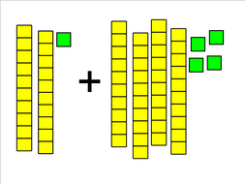
Concrete (Using base 10)
24 + 12 =

Slide 17
Concrete (Using base 10)
24 + 12 =36

Slide 18
Have a go challenge!
Can you solve the calculation using the base 10 or straws on your table.
35 + 22 = __

Slide 19
Pictorial (Using base 10)
24 + 12 =

Slide 20
Pictorial (Using base 10)
24 + 12 = 36

Slide 21
Have a go challenge!
Can you solve the calculation
using base 10 drawings.
37 + 25 = __

Slide 22
Pictorial (Writing 10s and 1s)
24 + 12 = __

Slide 23
Pictorial (Writing 10s and 1s)
24 + 12 = __
10
10
1
1
1
1
10
1
1

Slide 24
Pictorial (Writing 10s and 1s)
24 + 12 = __
10
10
1
1
1
1
10
1
1
30

Slide 25
Pictorial (Writing 10s and 1s)
24 + 12 = 36
10
10
1
1
1
1
10
1
1
36

Slide 26
Abstract (Partitioning)
24 + 12 = __

Slide 27
Abstract (Partitioning)
24 + 12 = __
24 + 10 = 34

Slide 28
Abstract (Partitioning)
24 + 12 = __
24 + 10 = 34
34 + 2 = 36

Slide 29
Abstract (Partitioning)
24 + 12 = 36
24 + 10 = 34
34 + 2 = 36

Slide 30
Have a go challenge!
Can you solve the calculation
using partitioning.
44 + 38 = __

Slide 32
Concrete (Using the straws)
24 - 12 =

Slide 33
Concrete (Using the straws)
24 - 13 = 11

Slide 34
Concrete (Using base 10)
24 - 13 =

Slide 35
Concrete (Using base 10)
24 - 13 = 11

Slide 36
Have a go challenge!
Can you solve the calculation using the base 10 or straws on your table.
25 - 13 = __

Slide 37
Pictorial (Using base 10)
24 - 13 =

Slide 38
Pictorial (Using base 10)
24 - 13 = 11

Slide 39
Have a go challenge!
Can you solve the calculation
using base 10 drawings.
57 - 34 = __

Slide 40
Abstract (Partitioning)
24 - 13 = __

Slide 41
Abstract (Partitioning)
24 - 13 = __
24 - 10 = 14

Slide 42
Abstract (Partitioning)
24 - 13 = __
24 - 10 = 14
14 - 3 = 11

Slide 43
Abstract (Partitioning)
24 - 13 = 11
24 - 10 = 14
14 - 3 = 11

Slide 44
Have a go challenge!
Can you solve the calculation
using partitioning.
64 - 45 = __

Slide 46
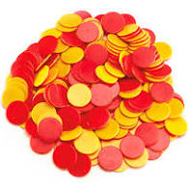
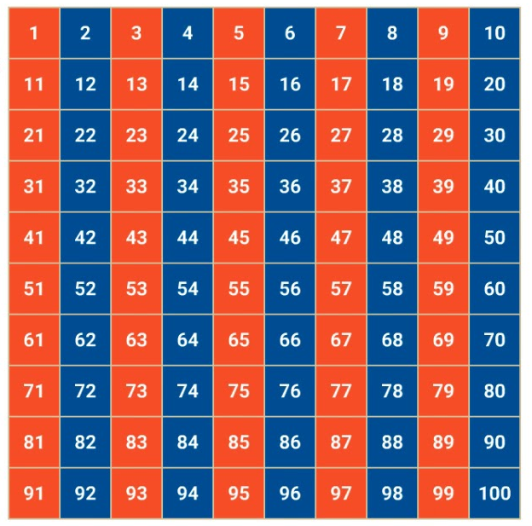
Resources used
Dividing
Houses
Counters
100 Square

Slide 48
Multiplication/Division Facts
Doubling and Halving.
Counting forwards and backwards in 2s.
Counting forwards and backwards in 5s.
Counting forwards and backwards in 10s.
Jack Hartmann Counting songs - https://www.youtube.com/channel/UCVcQH8A634mauPrGbWs7QlQ
Counting forwards and backwards in 3s.
Counting forwards and backwards in 4s.

Slide 49
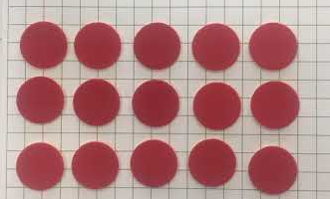
Concrete (Counters Arrays)
3 x 5 = __

Slide 50
Concrete (Counters Arrays)
3 x 5 = 15

Slide 51
Have a go challenge!
Can you solve the calculation using counters to make the array.
3 x 4 = __

Slide 52
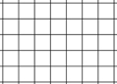
Pictorial (Dot Arrays)
3 x 5 = 15

Slide 53
Pictorial (Dot Arrays)
3 x 5 = 15

Slide 54
Have a go challenge!
Can you solve the calculation using arrays, drawing them on your paper.
2 x 7 = __

Slide 55
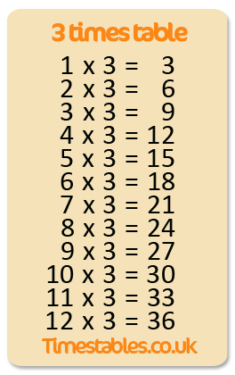
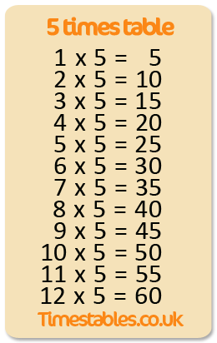
Abstract (Mental Facts)
3 x 5 = 15

Slide 57
Concrete (Counters Groupings)
15 ÷ 5 = __

Slide 58
Concrete (Counters Groupings)
15 ÷ 5 = 3
1
1
1
1
1
2
2
2
2
2
3
3
3
3
3

Slide 59
Have a go challenge!
Can you solve the calculation using counters to make groupings.
10 ÷ 2 = __

Slide 60
Pictorial (Groupings)
15 ÷ 5 = __

Slide 61
Pictorial (Groupings)
15 ÷ 5 = 3

Slide 62
Have a go challenge!
Can you solve the calculation using arrays, drawing them on your paper.
12 ÷ 3 = __

Slide 63
Abstract (Mental Facts)
15 ÷ 5 = __

Slide 64
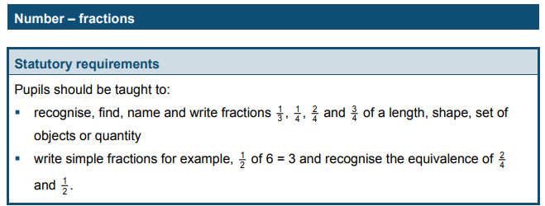

Slide 65
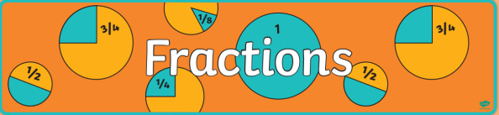
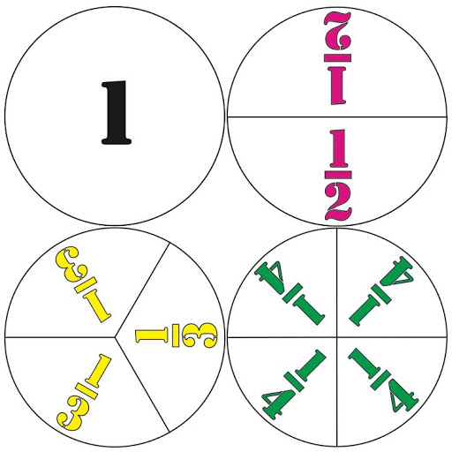

Slide 66
Concrete (Counters Groupings)
¼ of 12 =
1
4
7
10
2
5
8
11
3
6
9
12

Slide 67
Concrete (Counters Groupings)
¼ of 12 = 3
1
1
1
1
2
2
2
2
3
3
3
3

Slide 68
Pictorial (Bar Models)
¼ of 12 =
12

Slide 69
Pictorial (Bar Models)
¼ of 12 =
12

Slide 70
Pictorial (Bar Models)
¼ of 12 = 3
12
3

Slide 71
Pictorial (Bar Models)
¾ of 12 =
12

Slide 72
Pictorial (Bar Models)
¾ of 12 =
12

Slide 73
Pictorial (Bar Models)
¾ of 12 = 9
12
9

Slide 74
Have a go challenge!
Can you draw a bar model for the following calculation and find the answer.
¼ of 16 =

Slide 75
Abstract (Mental Fractions)
¼ of 12 = __
½ of 12 = 6

Slide 76
Abstract (Mental Fractions)
¼ of 12 = 3
½ of 12 = 6
½ of 6 = 3

Slide 77
Abstract (Mental Fractions)
¼ of 12 = 3
6
3

Slide 78
Abstract (Mental Fractions)
¼ of 12 = 3

Slide 79
Finding Halves of Bigger
Numbers (Linking Facts)
½ of 2 = 1
½ of 4 = 2
½ of 6 = 3
½ of 8 = 4
½ of 10 = 5
½ of 20 = 10
½ of 40 = 20
½ of 60 = 30
½ of 80 = 40
½ of 100 = 50

Slide 80
Online Resources
Jack Hartmann – Songs for learning patterns.
https://www.youtube.com/channel/UCVcQH8A634mauPrGbWs7QlQ
NCETM – Maths curriculum support.
https://www.ncetm.org.uk/resources/50640
White Rose – Problem Solving Documents.
https://whiterosemaths.com/homelearning/year-2/
Top Marks – Maths Games.
https://www.topmarks.co.uk/maths-games/5-7-years/counting
Government – Previous KS1 SATs Papers.
https://www.gov.uk/government/collections/national-curriculum-assessments-practice-materials

