Slide 1
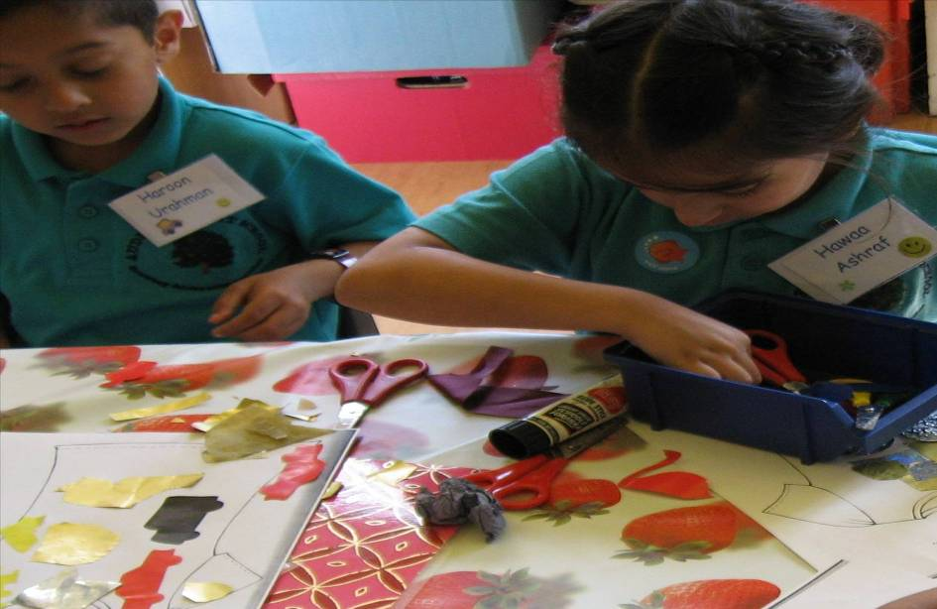

Welcome to Audley Infant School
Year Two

Slide 2

Your teachers
There are three teachers in Year Two:
Mrs S Massey
Miss V Aulton
Miss E Taylor

Slide 3
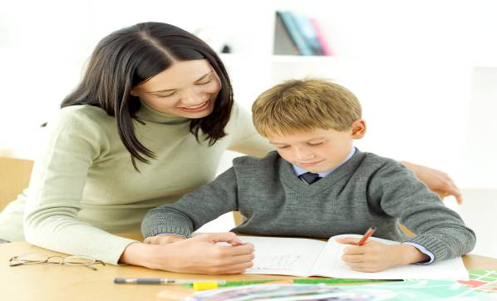
Classroom support
Each class has extra support from Teachers and teaching assistants
Classroom support in Y2
- Mrs. Holden
- Mrs. Grunshaw
Mrs. Yaqoob
Mrs. Baporia
Mrs Nagdee
All of our team are dedicated to providing the best education and care for your children.

Slide 4

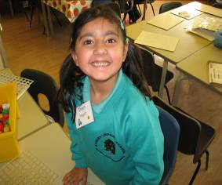
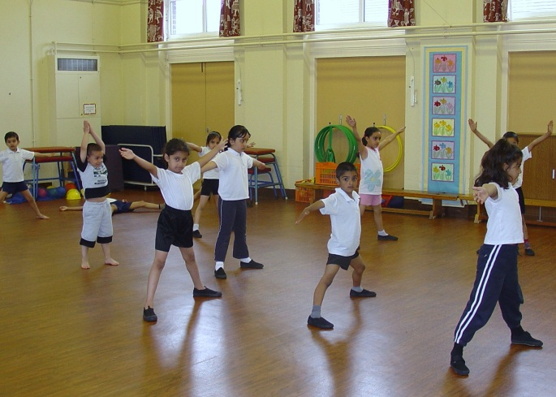
New Term
Please label all clothes (coats, jumpers etc.) and PE kits
PE Kit
Black shorts (leggings acceptable but not tracksuit bottoms)
White t-shirt
Black pumps.
Make sure that PE kits are in school each Monday.
NO JEWELLERY!!

Slide 5

Attendance
Be on time!!
Excellent attendance is celebrated.
The teachers will come on to the enclosed playground at 8.50am ready to take the children into school at 8.55am prompt. You must stay with your child until the class teacher is at the front of the line.
If your child arrives at school after 9.00am, they will be marked as late in the register. Persistently arriving in school late may result in a meeting with your child’s teacher and Mrs. Johnson, our family liaison officer.
School finishes at 3.05pm – your child must be collected promptly from the enclosed playground by a responsible adult (nobody under 14 is allowed to collect your child).

Slide 6

Persistent Absence
Our school is one of the worst in the area for poor attendance.
They can fall behind in their learning.
How can you help your child and the school?
It is important that your child attends school every day unless ill. Please inform the school as soon as you can if your child will be absent. If your child has a cold or cough, without a temperature, please send them to school and we will monitor them closely.
Please book appointments (for example dentist or doctor) for your child outside of school hours.

Slide 7
Behaviour
At Audley Infant School we pride ourselves on the excellent behaviour of our children.
To continue our high standards we expect our children to always use their very best manners and behaviour at all times.
Our school rules promote good behaviour and respect for others.
Children who show consistently good behaviour and manners will be rewarded with stickers and certificates.

Slide 8

Dinner time
School dinners are free for all children in the Infants.
You can request a menu and select the meals with your child if they are unhappy.

Slide 9
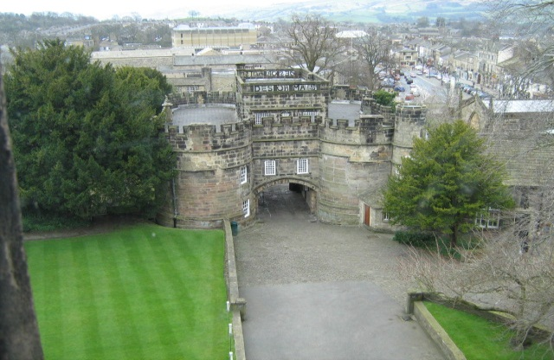
School Trips!
We hope to visit Skipton Castle
Children cover elements of the History, English and Art curriculum. There is also a theatre company visiting us to enhance our learning around the Great Fire of London, and a children’s entertainer visiting us in Autumn term.

Slide 10
Topics
Our topics are:
Fighting Fit!
Fire! Fire!
Awesome Asia
Roar!
Castles
Park Life!
Each half term we will send home a topic map in your child’s homework book showing what we will be learning.
Autumn Term
Spring Term
Summer Term

Slide 11
Information
During the year there will be opportunities for you to come into school and look at your child’s work.
Please check your child’s reading bag daily for any important information and homework.

Slide 12


Homework
Homework is sent home every week on Friday.
Please bring homework books back to school on Wednesday.
Please work with your child through the homework activity but do not complete it for them!
If your child wants to do more, look at the topic map sent home each half term for further ideas. You can access the school website and there are links to other educational websites.

Slide 13

English
Stories, non-fiction, re-tell, recount, fact file, poetry, newspaper reports, character descriptions, labels…
Writing
These are the skills that the government expect of your child at the end of the school year…
Sentences punctuated correctly with capital letters, full stops, question marks and exclamation marks.
Understand and use different types of sentences.
Use adjectives to describe a noun.
Use past and present tense correctly and consistently.
Use conjunctions (joining words) to join sentences and give reasons eg and, because, if, but, or.
Spell common words correctly.
Use apostrophes for contractions e.g. I’m, can’t, they’re.
Use suffixes to change words e.g. excite to excitement, happy to happiness, hope to hopeless, slow to slowly.

Slide 14

Reading
These are the skills that the government expect of your child at the end of the school year…
Read common words accurately .
Read fluently and with expression.
Use different strategies to read unfamiliar words e.g. sounding out, using pictures, using prior knowledge.
Check their reading makes sense.
Ask and answer questions, retell a story, find facts and predict.
To explain how and why things are happening from what they already know.
These are the ways we teach your child these reading skills…
Sharing stories
Reading with an adult
Guided reading

Slide 15

Please read daily with your child at home.
Home reading book - please comment in the reading record and try to listen to your child read EVERY DAY! (even if it is only a few pages)

Slide 16

Handwriting
We use cursive handwriting in class where all letters start on the line.
Please practice letter formation in your child’s homework book
This is an example of the cursive handwriting we use in school!

Slide 17

Maths
These are the skills that the government expect off your child at the end of the school year…
Place value
Addition & Subtraction
Multiplication & Division
Fractions
Money
Measurement
Time
2D and 3D shape
If you look at the half-termly overview, you will be able to see exactly what unit your child is learning.

Slide 18
Assessment
Due to recent government changes, children are no longer expected to sit their end of year SATs. However, children will be assessed throughout the year using teacher judgements.
If your child didn’t pass their Phonics screening, they will take part in small group interventions to prepare them for re-sitting their Phonics test in June.

Slide 19
Reports to parents
At the end of every term your child will bring home a short report about their progress and attitude to learning.
In the Autumn and Spring terms there will be parents evenings where you can discuss your child’s progress and how best to help them in their learning.
A full report will be sent home at the end of the Summer term
Parent drop-ins will take place each half-term where you will have the opportunity to look at your child’s work

Slide 20

We are looking forward to working with you all!!

