Slide 1

Year 1 Parent Workshop – Foundation Curriculum

Slide 2

Welcome to our parent workshop all about the foundation curriculum in Year 1.
The workshop today guides you through the curriculum year 1 children at Audley Infants will follow this academic year.
We will share teaching methods used, activities the children will complete, exciting trips they have the opportunity to go on to enhance their learning and online learning that can take place at home.

Slide 3
Foundation curriculum is taught every afternoon, subjects are taught through a topic and a different topic is the focus each half term, these include:
Autumn 1 Marvellous Me!
Autumn 2 Amazing Animals
Spring 1 Brilliant Blackburn
Spring 2 Mr Bloom
Summer 1 Transport
Summer 2 Wish you were here
We try to link visits, visitors and other wow experiences with each topic to make it memorable and to capture the children’s interest and develop their understanding. Due to current circumstances these wow events are postponed.
Each foundation subject is assessed by the class teacher and the children’s stage of development is included in their end of term report.

Slide 4

Science
At Audley Infants we want to provide our children with opportunities to investigate and enquire in order to
develop a greater curiosity and intrigue in the world in which they live.
Science teaching provides children with first-hand experiences and opportunities to work scientifically to develop their scientific understanding.
Children are encouraged to be curious and ask questions about what they notice. They are helped to develop their understanding of scientific ideas by using different types of scientific enquiry.
We encourage our children to use simple scientific language to talk about and record what they have found out.

Slide 5
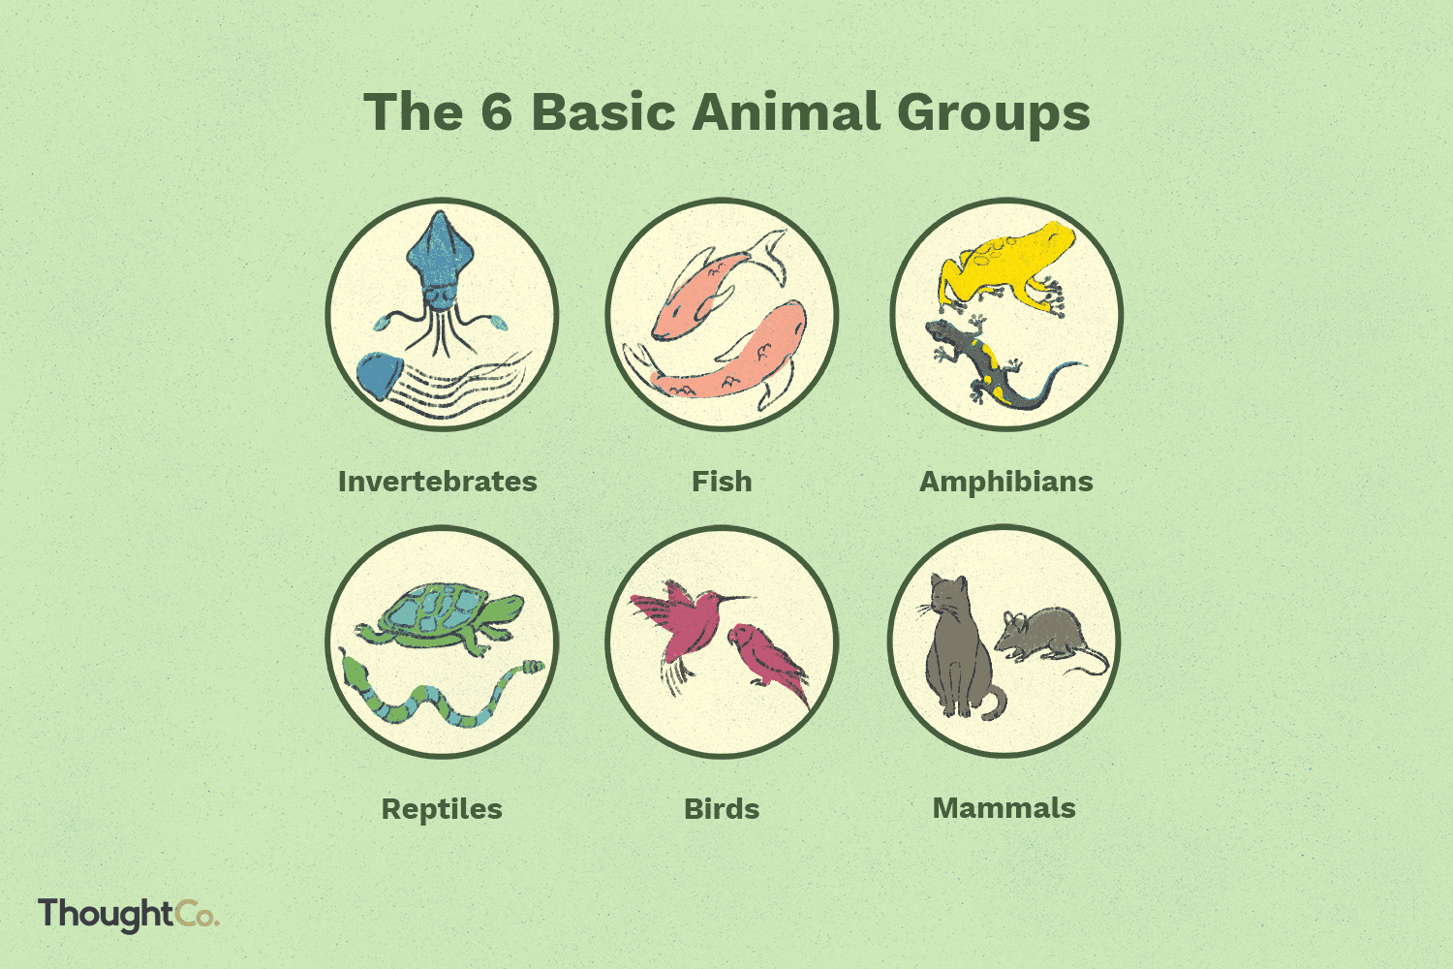
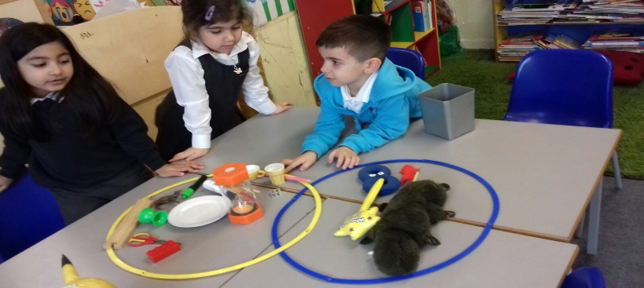
Year 1 children study animals including humans, they learn about:
Identify and name a variety of common animals including fish, amphibians, reptiles, birds and mammals
Identify and name a variety of common animals that are carnivores, herbivores and omnivores
describe and compare the structure of a variety of common animals (fish,
amphibians, reptiles, birds and mammals including pets)
identify, name, draw and label the basic parts of the human body and say
which part of the body is associated with each sense
We also study materials:
Distinguish between an object and the material from which it is made
identify and name a variety of everyday materials, including
wood, plastic, glass, metal, water, and rock
describe the simple physical properties of a variety of
everyday materials
compare and group together a variety of everyday materials
on the basis of their simple physical properties

Slide 6
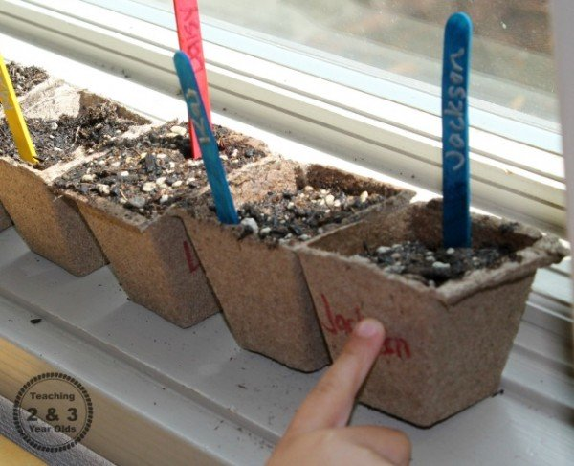
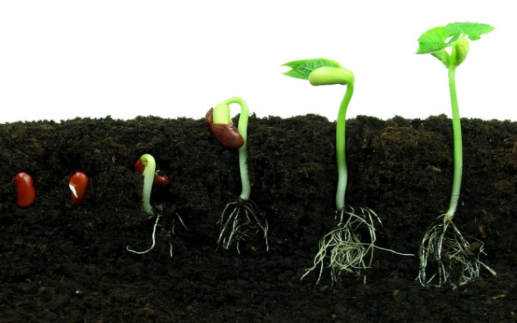
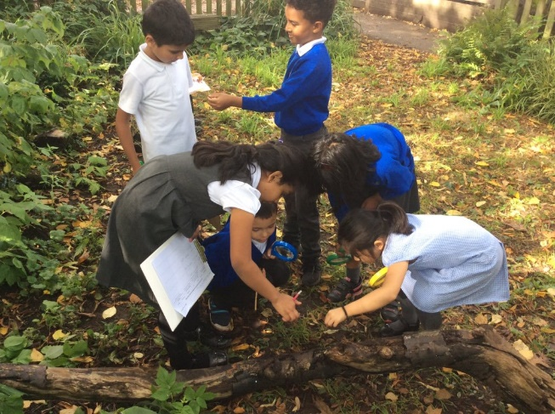
Year 1 children learn about plants. At Audley we:
Identify and name a variety of common wild and garden plants, including deciduous and evergreen trees.
Identify and describe the basic structure of a variety of common flowering plants, including trees
Alongside these 3 areas of learning children in year 1 are asked to
observe, discuss and write about the changes across the four
seasons and the weather associated with the seasons and how
day length varies.

Slide 7
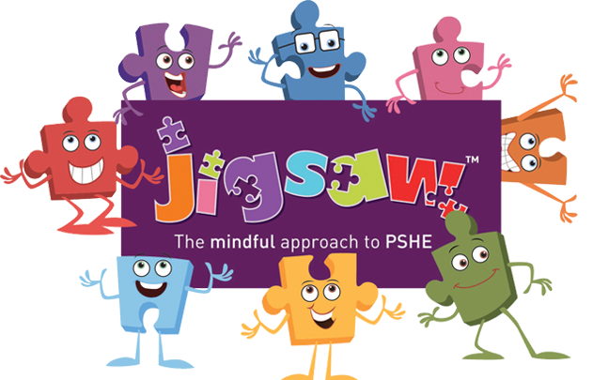
PSHE
PSHE stands for personal, social and health education. At Audley Infants we deliver our PSHE curriculum through a scheme called ‘Jigsaw’.
It enables our children to acquire the knowledge, understanding and skills they need to manage their lives – now and in the future.
Jigsaw deals with the diverse beliefs, values and attitudes that individuals and societies hold. It encourages mutual respect, responsibility and positive self-esteem.
All year groups work on the same theme (puzzle) at the same time. This enables us to start each puzzle with a whole school assembly. The different ‘puzzle pieces’ for the jigsaw are:
Being me in my world
Celebrating difference
Dreams and goals
Relationships
Changing me
Healthy me

Slide 8
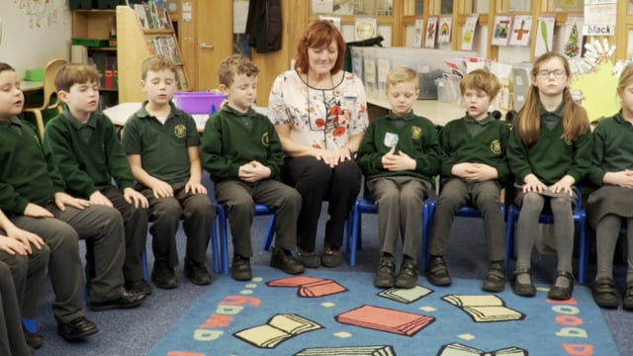
The ‘Calm Me’ part of the lesson is incredibly important and enjoyed by children at Audley.
We use this activity to help develop mindfulness, to help calm
ourselves down and get ready to learn more. Here you can
see an example used in class.
Audley children will gain an understanding of British Values that are necessary if they are to make sense of their experiences, value themselves, respect others, appreciate differences and feel confident as a British citizen.
Through PSHE, we believe we can enhance children’s education and help them to become caring, respectful and confident individuals.

Slide 9
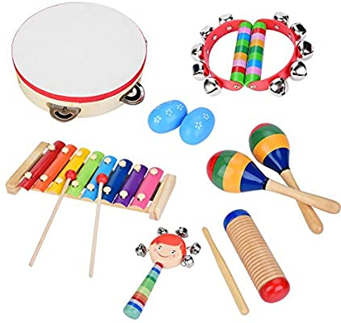
Music
Music teaching at Audley Infants is practical, fun and engaging. It provides our pupils with an understanding and appreciation for music, studying a wide range of musical styles and genres.
The curriculum ensures children sing, listen, play, perform and evaluate.
Music lessons typically involve a combination of the following; games, songs, challenges, listening to music and discussing music, playing a range of musical instruments, performing back, finding the pulse and composing music.
Through discussion children are asked to share their thoughts,
opinions and ideas, acknowledging and accepting that these
may vary and that this is a positive.
At Audley Infants children are provided with opportunities
beyond the national curriculum to further support their
understanding, these include mini sing, school productions
and an end of term performance by each class.

Slide 10
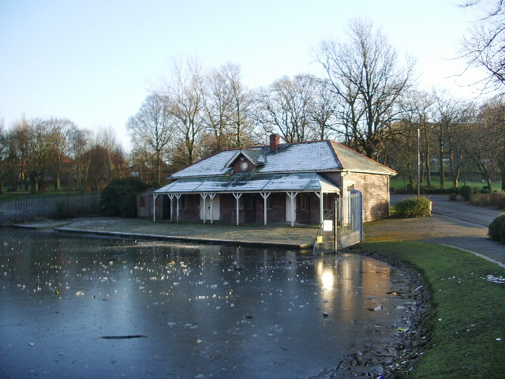
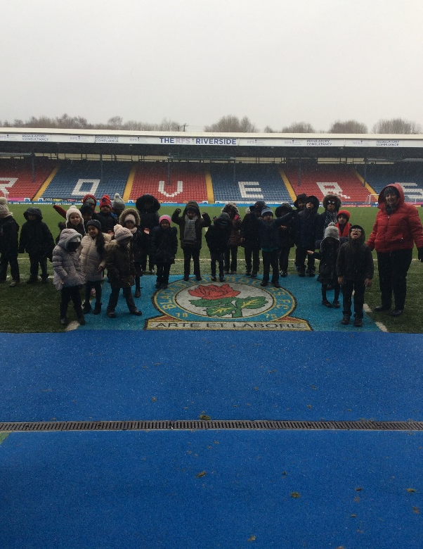
History
At Audley, we believe a high quality history education
will help our children develop their knowledge and
understanding of Britain’s past and that of the wider world.
We aim to inspire children’s curiosity about exploring people and events from the past. We want to teach children how to ask and answer questions about the past, develop their inquisitive minds and help them love learning about history. Year 1 children will use a variety of artefacts to help them to ask and answer questions.
Audley children will learn about:
Events beyond living memory, including Orville Wright inventing the
aeroplane.
Past and present transport, including new innovations.
A significant place in their locality, Queen’s Park, including work on
Queen Victoria and the Victorian era.
The history curriculum is enhanced through a visit to Blackburn Rovers.

Slide 11
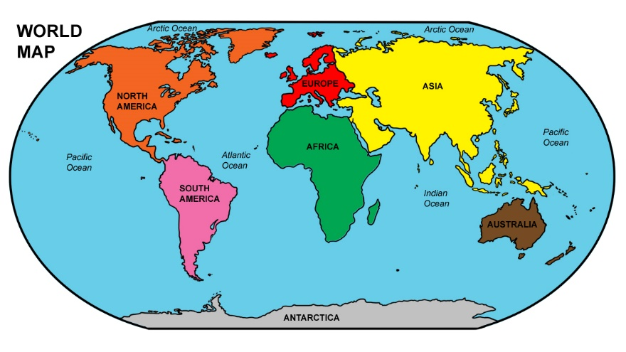
Geography
At Audley, we believe that Geography helps our
children to ask and answer questions about the
natural and human world. Geography promotes
children’s curiosity, interest and understanding
about places, people and environment.
Year 1 children will:
Name 7 continents and 5 oceans of the world using world maps, atlases and globes.
Identify seasonal and daily weather patterns in the UK and the location of hot and cold areas of the world in relation to the equator and the North and South Poles.
Learn simple compass directions and directional language to describe the location of features and routes on a map
Use aerial photographs of the local area, locating their home, familiar landmarks, buildings and features within the local environment.
Use observational skills during simple fieldwork to describe and record physical and human features of their environment (Queen’s Park)
Devising a simple map for our school including a key using basic symbols.

Slide 12
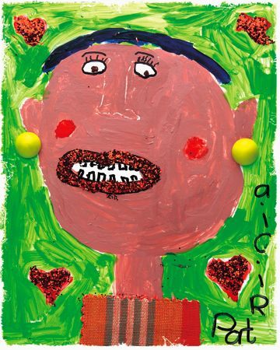
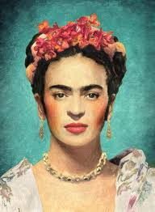
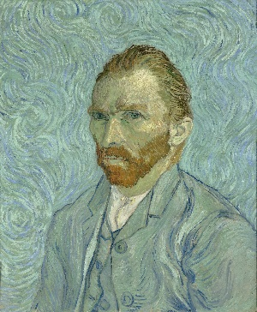
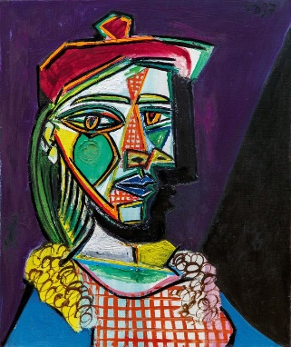
Art
The children at Audley infants love art lessons, it gives them the opportunity to express their individual interests, thoughts and ideas. The art we cover introduces our children to cultures from around the world and to a variety of artists. As pupils develop their own artwork, they will be challenged to think critically and creatively.
Children in year 1 are taught art through topic based learning lessons.
They study the work of Frida Kahlo, Vincent Van Gogh and Picasso
Before using sketching pencils, pastels and pastels to create a
self portrait,

Slide 13
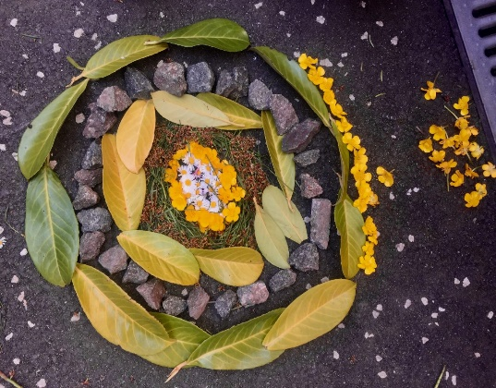
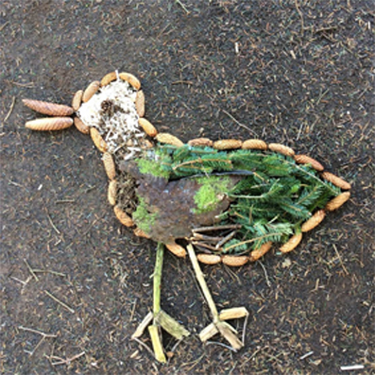

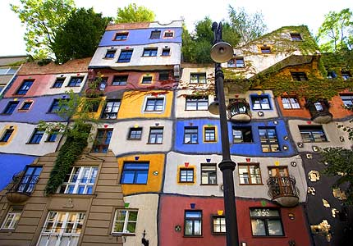
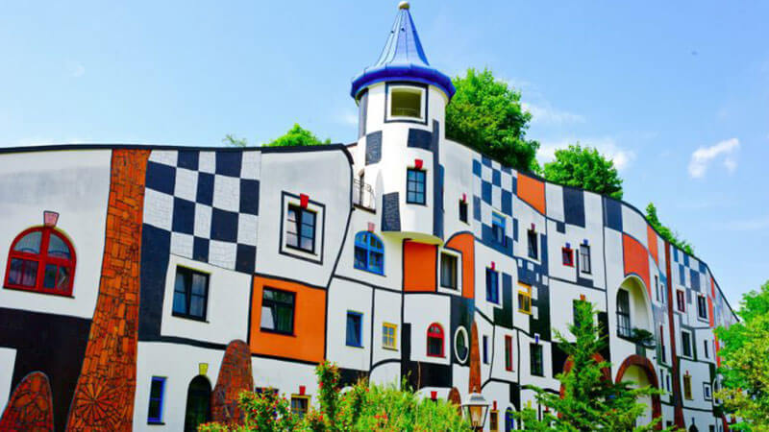
Year 1 experiment with colour mixing when they study the work of Andy Goldsworthy. They create different shades of natural colours. We use our extensive school grounds to collect natural materials and use these to create a piece of transient art.
During spring Year 1 look at the work of Hundertwasser, exploring his work on buildings, they investigate his use of lines and techniques when producing their own pieces of work. We learn about adding texture to paint and the effect this has, the children use a range of products including washing powder, sawdust, rice, sand etc.

Slide 14
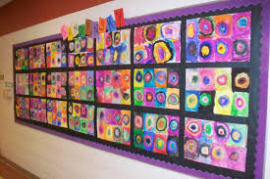
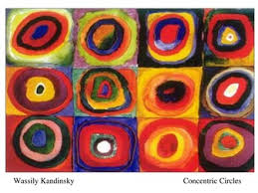
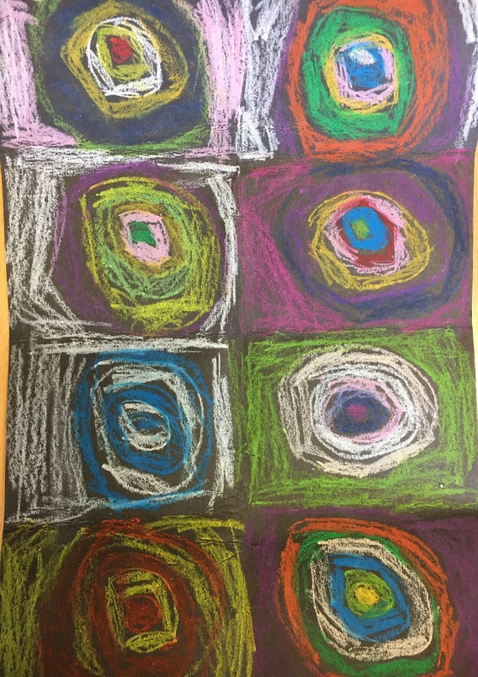
In the summer term Year 1 study the work of Wassily Kandinsky. They create hot and cold colours and produce a painting in the style of Kandinsky’s concentric circles. They use different media to
create their piece including pastels, chalks, paint and
crayons.
Our children’s creativity is extended with opportunities of visiting artists hosting children’s workshops and producing some beautiful art that is displayed in school.

Slide 15
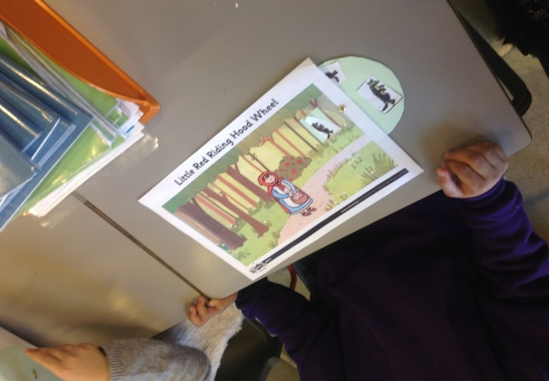
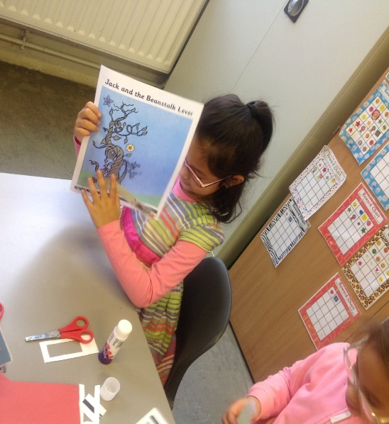
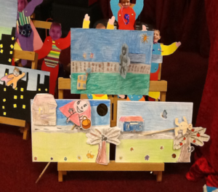
DT
At Audley, we provide opportunities for all children to use creativity and imagination to design and make products that solve problems, thinking about their own and others’ ideas. We want to inspire them to be the designers and makers of our future.
Year 1 study: food technology, mechanisms and structure.
In the spring term, year 1 children learn how to create a lever to make a moving picture.
They link the unit of work to the traditional tales
They have heard in class.
Year 1 explore different moving books to inspire their own ideas. They learn how to create a lever to allow their picture to move. Finally they design their moving picture, create it and evaluate how well it worked.

Slide 16
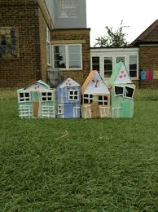
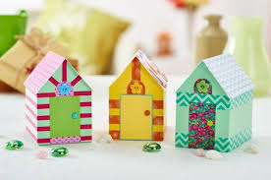
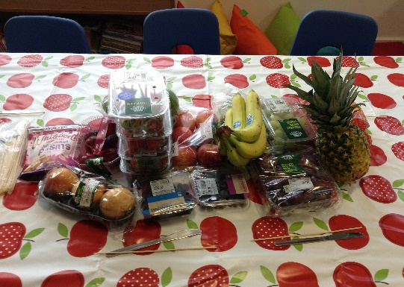
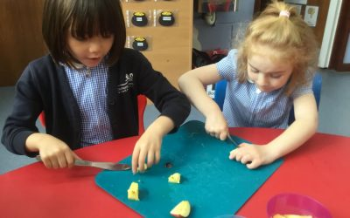
In the spring year 1 study food. They learn the names of different vegetables and find out where they grow.
The children choose their favourite root vegetables and prepare a salad using them.
Later in the unit the children
Have the opportunity to taste
different fruits and use their
favourites to design a fruit
Salad.
During the structures unit the children plan and design a beach hut.
We link this to our trip to St Annes where the children explore the beach huts there, evaluate them and understand their purpose.
The children explore structures
using construction kits before designing and making their own.

Slide 17

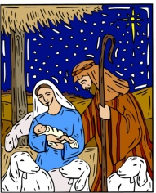


RE
Through our RE curriculum we aim for all our children to have a voice and be able to show tolerance and mutual respect for others whilst celebrating diversity and nurturing strong relationships. At Audley, RE provides opportunities to develop children’s knowledge and understanding of world religions.
In year 2 children focus on the Christian and Jewish faith. They learn what people following these faiths believe, how they express their faith and how their lives reflect their religion.
The key questions taught in year 1 are:
What does it mean to belong to a faith community?
How and why do we celebrate sacred and special times?
Who is Christian and what do they believe?
What makes some places sacred?
RE at Audley School is designed to celebrate all religions, faiths and communities and promote tolerance and respect preparing our pupils for life in our ever growing, diverse local community and world.

Slide 18
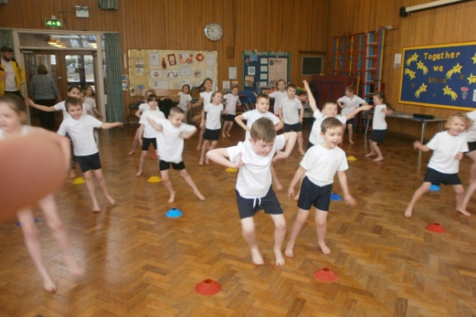
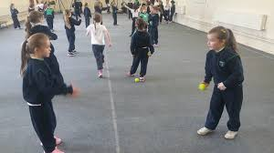
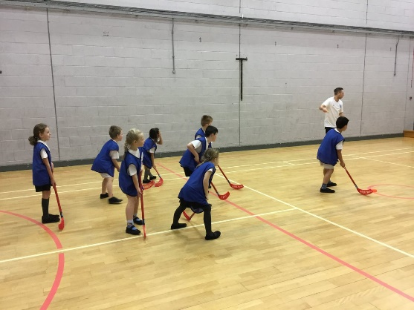
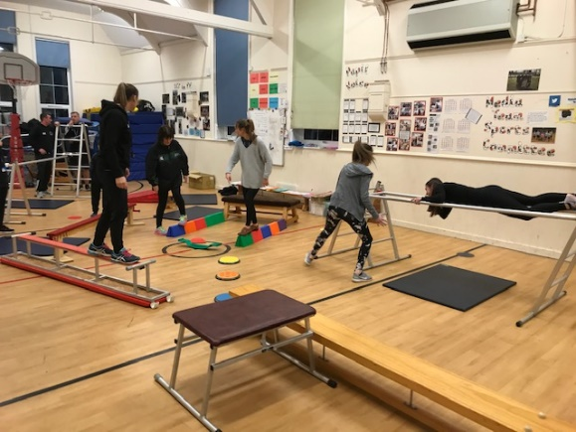
PE
Our aim in PE to develop pupils who will be physically active and can flourish in a range of different physical activities and sports. We have created a varied curriculum so children have the opportunity to learn a range of sports and play different games. PE at Audley is inclusive and engages all pupils.
PE covers 4 areas: dance, gymnastics, fundamentals and team games and athletics.
Through dance year 1 will move to different music, performing their
own short dance.
Athletics will focus on speed and direction and accurately throwing
in a variety of ways.
Gymnastics will allow the children to build a short sequence
containing different travels and rolls.
Fundamentals and team games will allow them to play simple
team games and develop their understanding of the specific
skill needed to play.

Slide 19

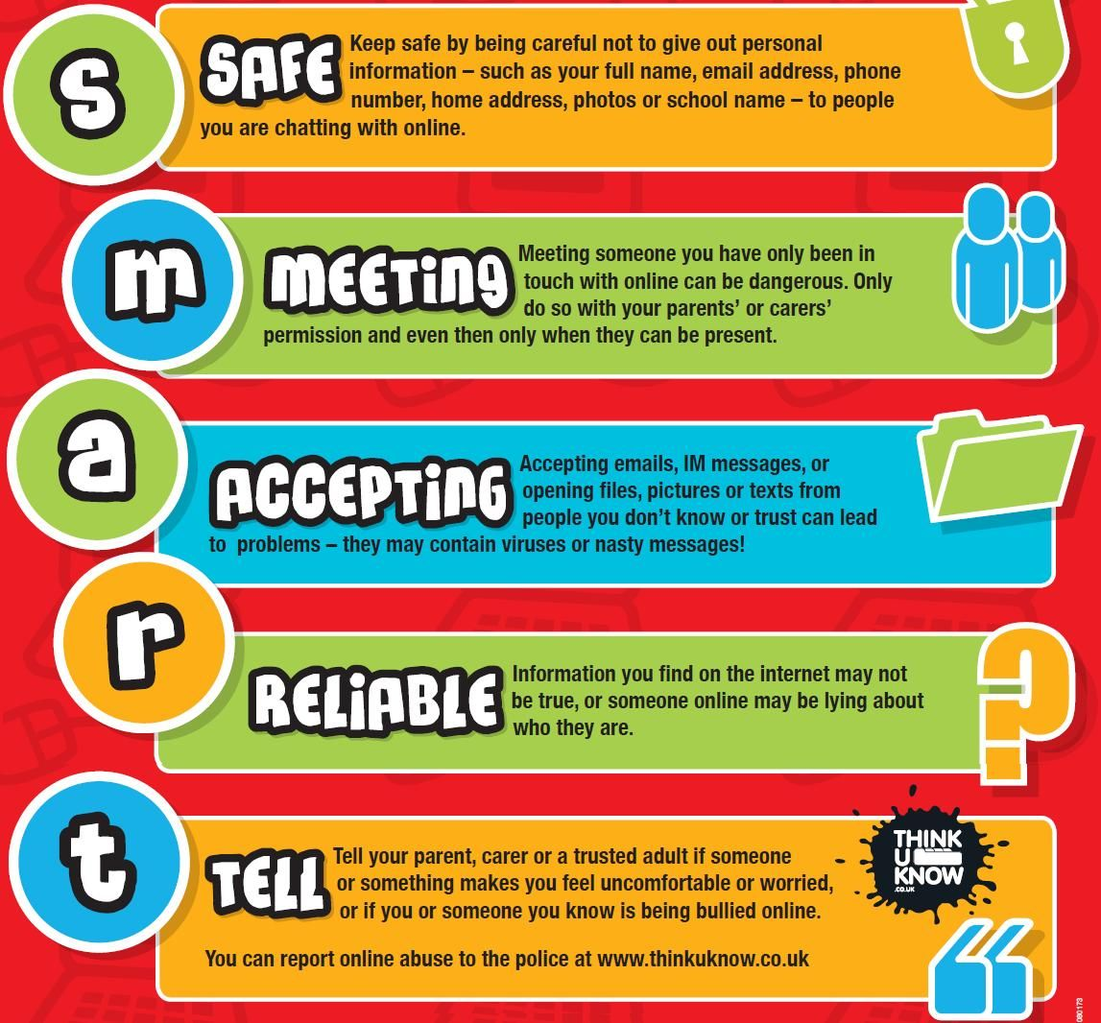
Computing
We want to equip the children of Audley with the skills, knowledge and understanding to participate in a rapidly changing world of technology. Our intention is to develop their skills to use technology effectively and become independent in their learning.
At the forefront of teaching computing in Audley Infant school is online safety. Children are taught how to stay safe whilst using technology and what they should do if they come across something they don’t like.
They are educated in the importance of keeping
passwords and personal information private and
know who they can talk to if they are concerned
or upset.

Slide 20
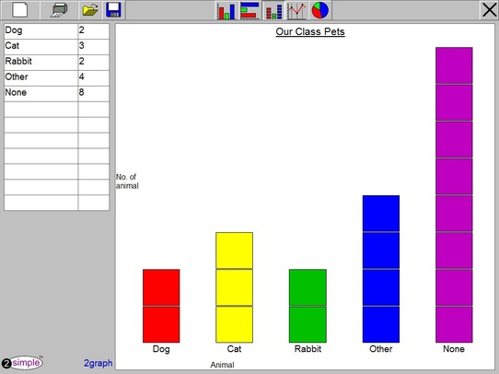
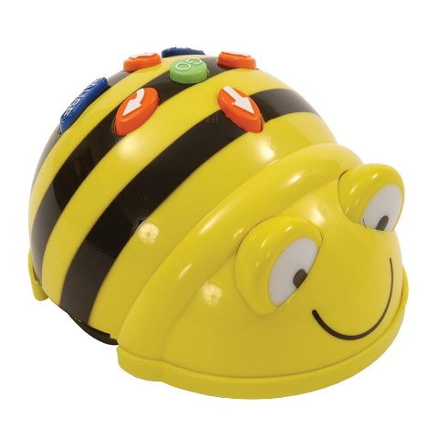

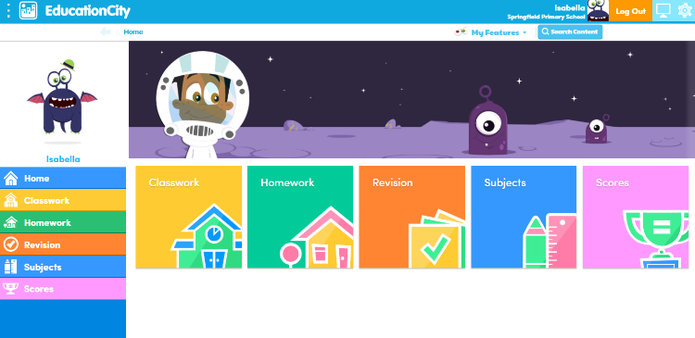
During year 1 children will:
Collect data relating to the topic being studied and learn
how they represent this in a variety of ways using charts.
Learn how to locate specific websites and send electronic mail
Use graphics software to recreate different styles of art, exploring tools that change the size and colour of lines and shapes.
Become computer programmers, through the use of a simple floor robot, implementing algorithms (a series of instructions).
You can support your child at home using the purple mash and education city log ins which have a wealth of games, ideas and resources linked to all areas of the curriculum.

