Slide 2
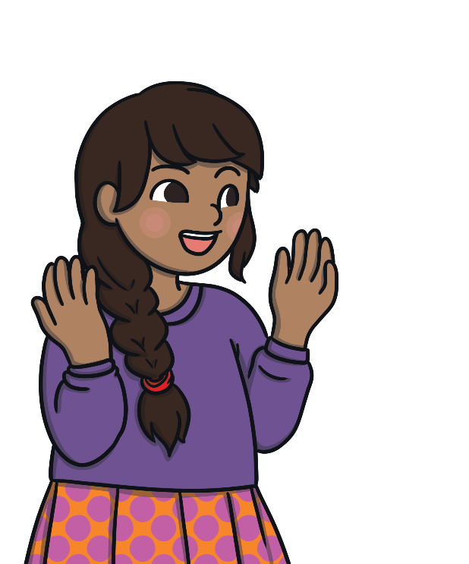
Did You Know…?
The English language has:
over 100 ways to spell those sounds
26 letters
44 sounds
x
u
a
e

Slide 3

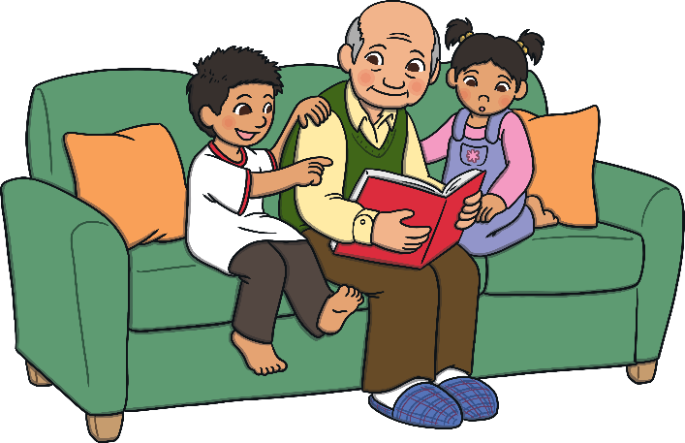
What Is Phonics?
reading and spelling
hearing, recognising and using sounds
routine and familiarity
focus on breaking down and building up words (segmenting and blending)
tricky/common exception words
Notes:
Typically, children begin to develop the listening skills essential to phonics in their preschool years. Some children begin to learn letter sounds at preschool but most children will begin their main phonics learning once they start their reception year at primary school (age 4-5). This teaching continues through year 1 (age 5-6) and into year 2 (age 6-7) until the child is a confident and fluent reader.
Once children are fluent readers, the emphasis in reading teaching moves more towards comprehension and analysis skills.
Book skills include holding books correctly, turning pages right to left, recognising that print represents words, talking about pictures, retelling familiar stories, asking and answering questions about stories and non-fiction texts and treating books with respect.

Slide 4


Phonics Terminology
You hear a phoneme
You see a grapheme
phoneme - Any one of the 44 sounds which make up words in the English language.
grapheme – How a phoneme is written down. There can be more than one way to spell a phoneme. For example, the phoneme ‘ai’ is spelt differently in each of the words ‘way’, ‘make’, ‘fail’, ‘great’, ‘sleigh’ and ‘lady’.
blending – Putting together the sounds in a word in order to read it, e.g. ‘f – r – o – g, frog’.
segmenting – Breaking a word into its constituent sounds in order to spell them, e.g. ‘frog, f – r – o – g’.
Notes:
It can be interesting to see how many ways there are to spell other sounds – try ‘igh’, ‘ee’ or ‘ow’.
A fun way to learn blending with young children is to talk to them in segmented words, for example ‘Please g – e – t’ the ‘m – i – l – k’ out of the ‘f – r – i – dge’.
When children begin to segment to spell they will often use the wrong spelling of phonemes, for example ‘I luv yoo’ or ‘Migh naym is…’. This is not a problem, as the key skill at this stage is that they can hear the sounds in the words and have a go at writing them down.

Slide 5
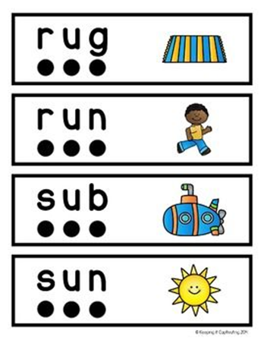
How to say the sounds
This is where we recognise the letter sounds in a written word and merge or ‘blend’ them in the order they are written to pronounce the word
We use our ‘blending hands’ to say each sound, bringing our hands together to say the word.
https://www.youtube.com/watch?v=3ovJIxTQpsU&t=55s
c – u – p
d – ar – k
ch – ai – n

Slide 6

Segmenting
This is where we ‘chop up’ the word to spell it out – so we say each of the phonemes separately.
We use our ‘phoneme fingers’ to say each sound in the word.
It is the opposite of blending.
We identify the individual sounds in a spoken word
h-i-m,
s-t-or-k
We write down the letters for each sound to form the word ‘him’ and ‘stork’.

Slide 7
Tricky Words
Some words are not phonically decodable (you can’t sound them out) – the children are not able to read them initially using the phonemes they have learned
Phase 2 – I no go to the into
Phase 3 – me be he she we are you they was all my her
Phase 4 – said have like so do come some little one were there out what when
Your child may bring home some tricky words in their reading bag – please help them learn to read them by sight.

Slide 8
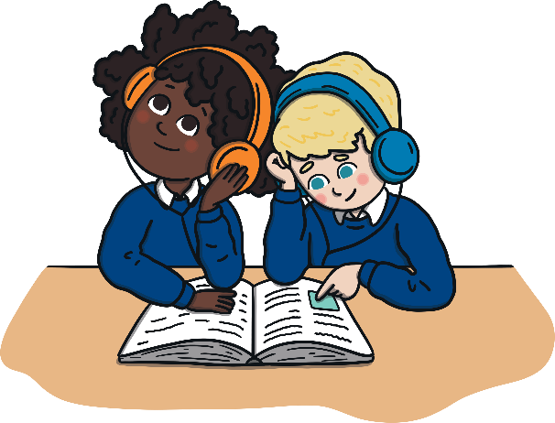
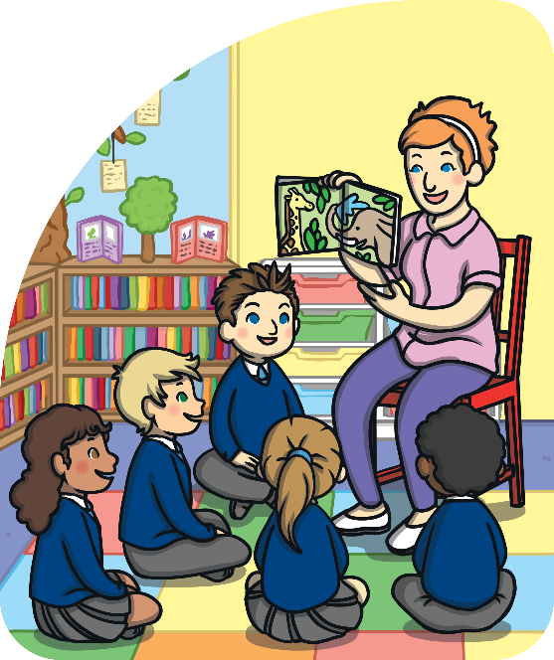
The Progression of Phonics
You may wish to change some of the wording in this section based upon the year groups that you cater for in your school as well as your chosen phonics scheme. Please delete this instruction.
Phase One - nursery/F1 and/or reception/F2
Phase Two - reception/F2
Phase Three - reception/F2
Phase Four - reception/F2
Phase Five - year 1
Phase Six - year 2
Notes:
Phonics is taught in phases and typically is taught between Nursery/F1 and Year 2. However, some children in older years might take part in phonics interventions if there are any gaps in their knowledge.
Typical progression in Phonics is as follows:
Phase One - nursery/F1-reception/F2
Phase Two - reception/F2
Phase Three - reception/F2
Phase Four - reception/F2
Phase Five - year 1
Phase Six - year 2

Slide 9
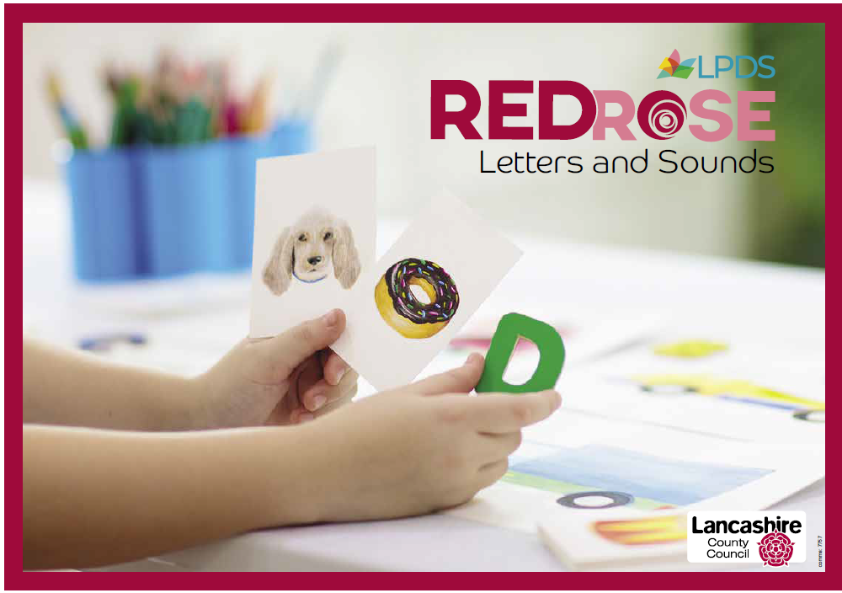
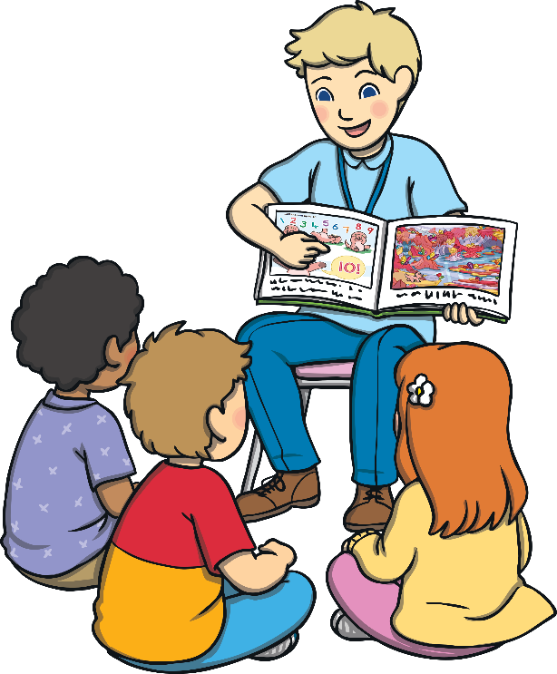
Our Phonics Scheme
Red Rose Scheme from Lancashire

Slide 10
Teaching Phonics
Children are taught reading and spelling daily throughout the week and each session will follow a structured format.
Revisit & Review
The activities used to teach will vary and can be adapted. They are multisensory and appeal to different learning styles. They involve games and individual and group activities as well as teacher-led sessions.
Teach
Practise
Teachers will assess children’s understanding throughout each session and will also assess knowledge of sounds to see whether a child is ready to move on to the next phase.
Apply
Notes:
Assessment at the end of a phase will usually involve asking children to name sounds to check that they know all of the Phase 2 sounds before they move on to Phase 3. Teachers may also assess ability to blend sounds to read words.

Slide 11



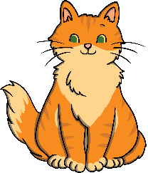

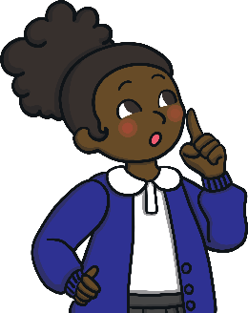

Phase One
Phase 1 has seven aspects, with a focus on listening skills.
Environmental sounds
Instrumental sounds
Body percussion
Rhythm and rhyme
Alliteration
Voice sounds
Oral blending and segmenting
Notes:
Environmental sounds – sounds we hear around us every day; listening to and imitating sounds; how to be a good listener. Ideas – make sounds to copy, e.g. sh sh sh, zzzzzz, p-p-p-p; go on a ‘listening walk’ – what can you hear?; talk about how to be a good listener; sing songs that require repetition and response, e.g. ‘Old MacDonald’.
Instrumental sounds – listening to and discriminating the sounds made by different instruments. Ideas – make sounds with a range of different instruments (non-musical instruments such as pots, pans, home-made shakers will all do); play an echo game where children have to copy a rhythm; hide an instrument behind a box or screen and play it, children have to say which instrument you are playing.
Body percussion – using the body to create sounds and follow a song, rhyme or beat. Ideas – sing songs that require actions, such as ‘Wind the Bobbin Up’, ‘Heads, Shoulders, Knees and Toes’, ‘If You’re Happy and You Know It, Clap Your Hands’; pass a body percussion sound around a group, e.g. sit in a circle or opposite one another, take turns to produce a body percussion sound which is then passed on, e.g. tap on shoulders, clap hands, stamp feet.
Rhythm and rhyme – recognising rhythms and rhymes in songs, speech and nursery rhymes. Ideas – sing and chant rhyming songs; read stories with repetition and rhyme, e.g. ‘The Gingerbread Man’, ‘Each Peach Pear Plum’; play a matching game with pictures of rhyming objects, e.g. frog/dog, hat/cat, mouse/house; clap the rhythm of phrases and rhymes or the syllables in words or names; play ‘I Spy’ – ‘I spy, with my little eye, something that rhymes with….’ Example game on next slide.

Slide 12
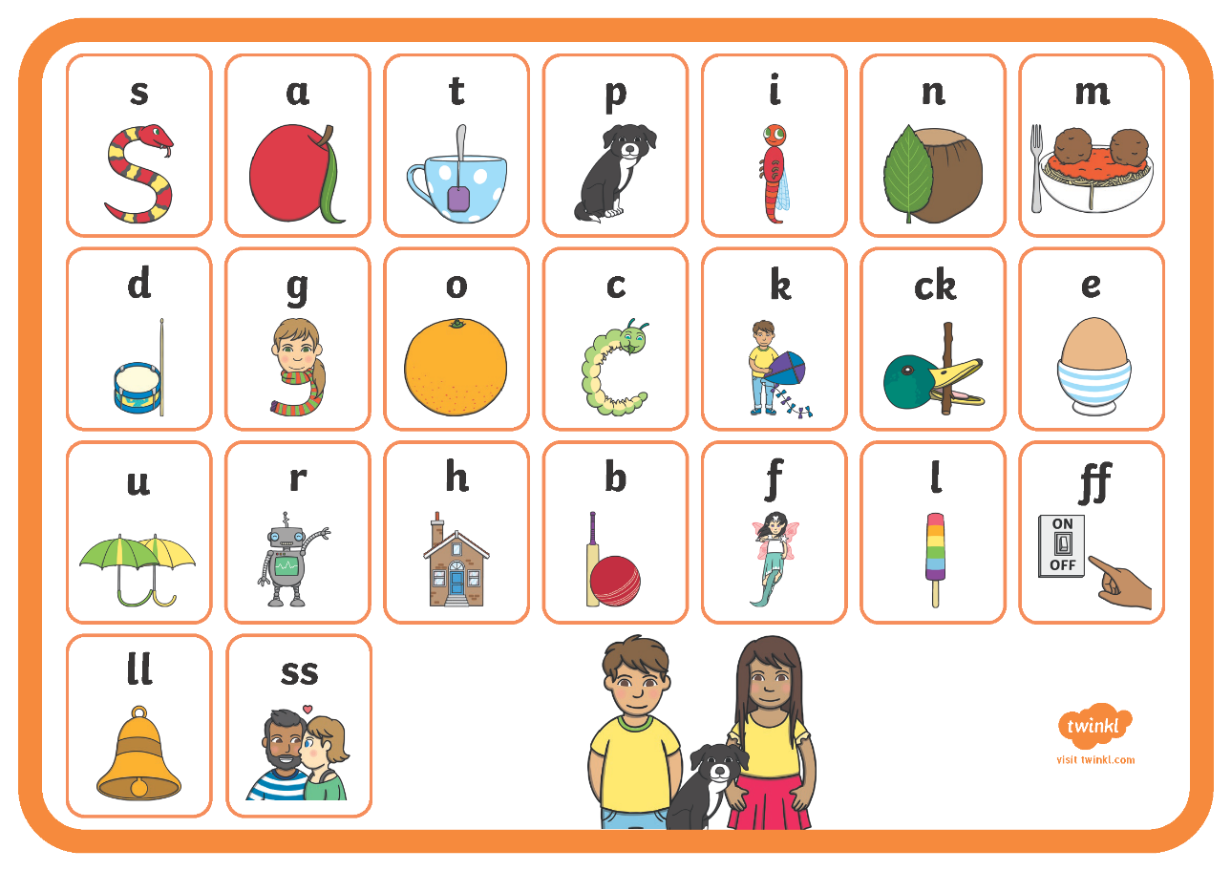
Phase Two
Notes:
Set 1: s, a, t, p
Set 2: i, n, m, d
Set 3: g, o, c, k
Set 4: ck, e, u, r
Set 5: h, b, f, ff, l, ll, ss
Phase 2 usually begins when children start their formal education in reception, though some preschools may also begin to teach letter sounds.

Slide 13
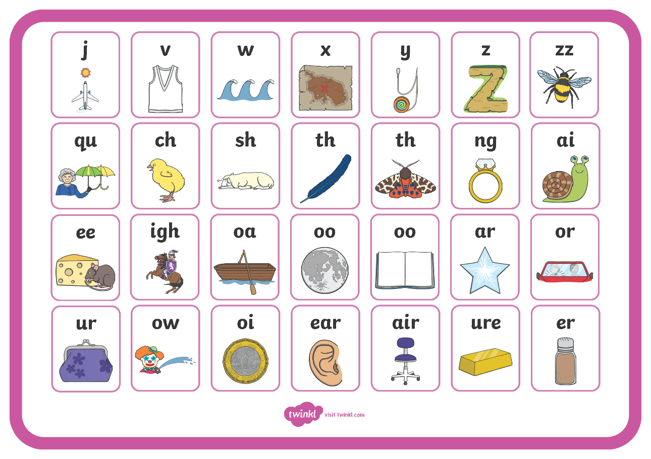
Phase Three
Notes:
Set 6: j, v, w, x
Set 7: y, z, zz, qu
Consonant digraphs: ch, sh, th, ng
Vowel digraphs: ai, ee, igh, oa, oo, ar, or, ur, ow, oi, ear, air, ure, er

Slide 14
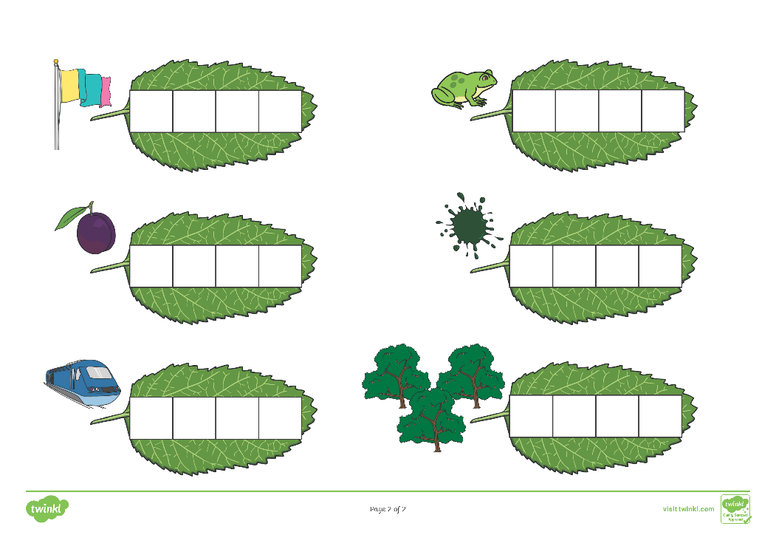
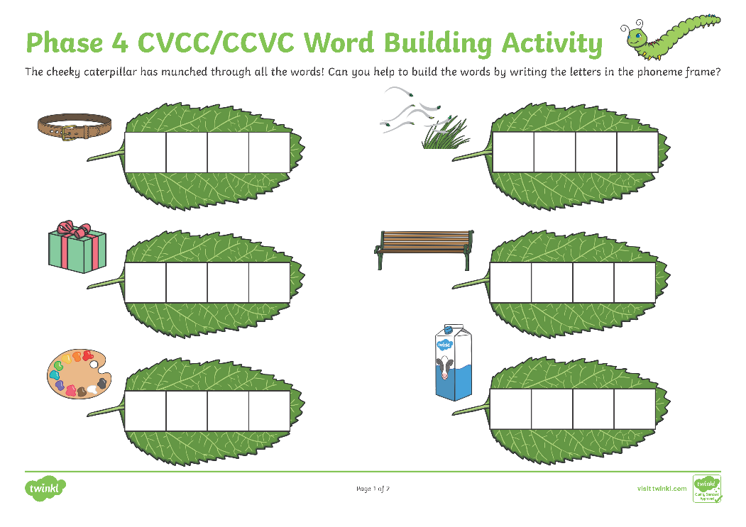
Phase Four
Phase 4 uses the same sounds as phase 3 but we build bigger words.
Notes:
Set 6: j, v, w, x
Set 7: y, z, zz, qu
Consonant digraphs: ch, sh, th, ng
Vowel digraphs: ai, ee, igh, oa, oo, ar, or, ur, ow, oi, ear, air, ure, er

Slide 15
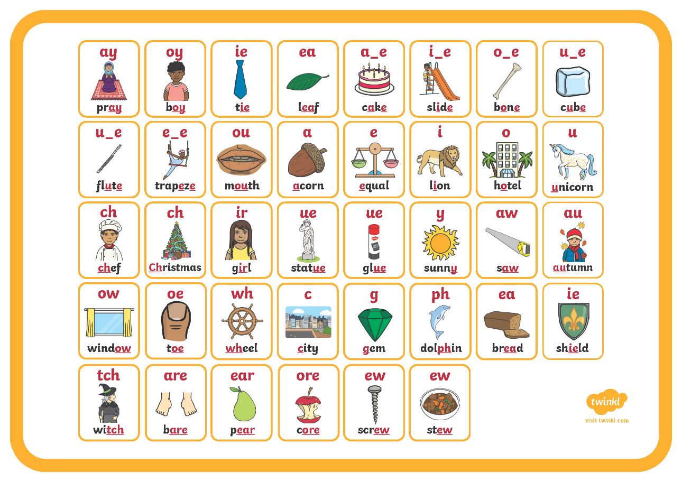
Phase Five
Notes:
Children will be taught new graphemes and alternative graphemes for the sounds they already know. They will begin to learn to choose the appropriate grapheme when spelling. The children will be automatically decoding a large number of words for reading by this point.

Slide 16
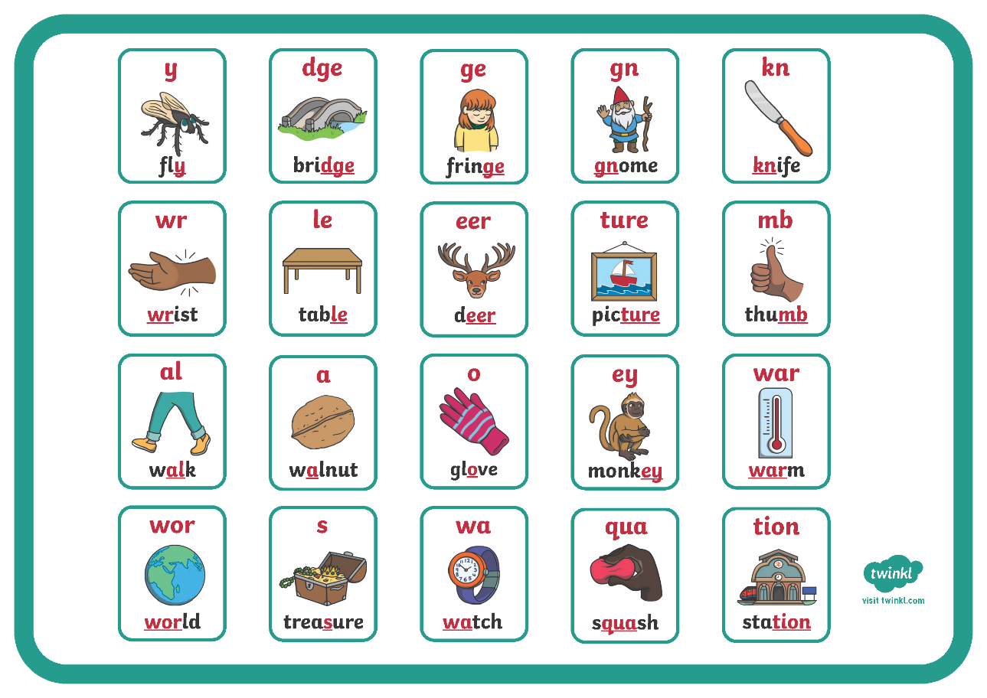
Phase Six
You may wish to replace this sound mat with one from your chosen scheme. Please delete this instruction.
Notes:
In Phase 6, children will be reading longer and less familiar texts independently and fluently. It is crucial that, at this point, children are now reading to learn and reading for pleasure.
Children should be able to read the 300 high-frequency words. At this point, it is important that comprehension strategies are developed so that children clarify meaning, ask and answer questions about the texts that they are reading, construct mental images during reading and summarise what they have read.
In spelling, children are introduced to the adding of suffixes and how to spell longer words. Throughout the phase, children are encouraged to develop strategies for learning spellings.

Slide 17
How to say the sounds
Saying the sounds correctly with your child is extremely important
The way we say the sound may well be different from when you were at school!
We say the shortest form of the sounds
https://www.youtube.com/watch?v=V32pB2lposo

Slide 18
Now for the Tricky bit!
Phonemes ( how it sounds) are represented by graphemes (how it looks).
A grapheme can consist of 1, 2 or more letters.
A phoneme can be represented/spelled in more than one way (c – cat, kennel, choir; oo – moon, book; ow – snow, now).
The same grapheme may represent more than one phoneme (me, met) – it looks the same but sounds different.

Slide 19
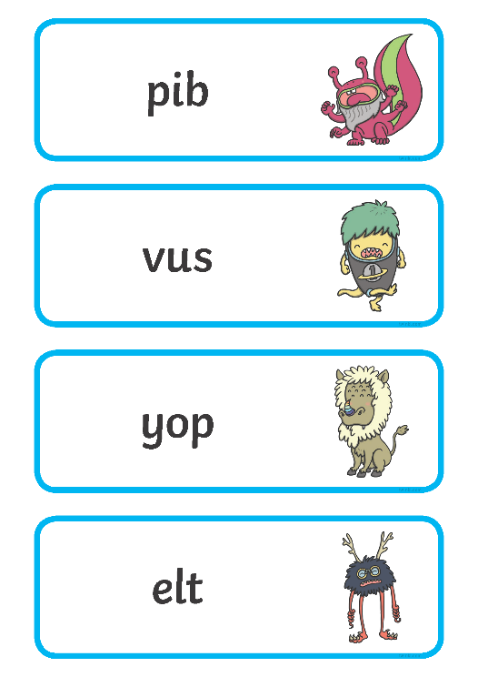
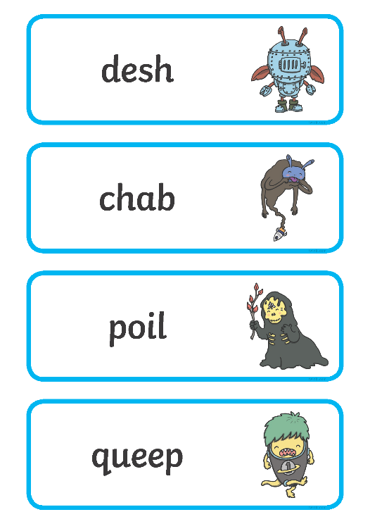
The Year 1 Phonics Screening Check
In June, all year 1 children are expected to complete the year 1 Phonics Screening Check.
The aim is to check that a child is making progress in phonics. They are expected to read a mixture of real words and ‘nonsense’ words.
The outcome of this check enables practitioners to see if any children may need additional support to help them make progress in year 2.
Notes:
Pupils who have achieved the expected standard at the end of year 1 will have experience of decoding all of the types of words that appear in the year 1 phonics screening check. They will know the correct grapheme to go with most sounds and be able to blend phonemes in words in the screening check.
‘Nonsense’ words or ‘alien’ words are designed to test pure phonic ability rather than knowledge of words. Examples might include ‘baf’, ‘gip’, ‘leet’, ‘stoof’.
For more information about the format of the phonics check, see Twinkl’s ‘Year 1 Phonics Screening Check’ Powerpoint.
Click on hyperlink to view Screening check from last year

Slide 20

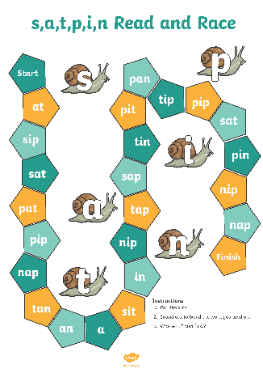
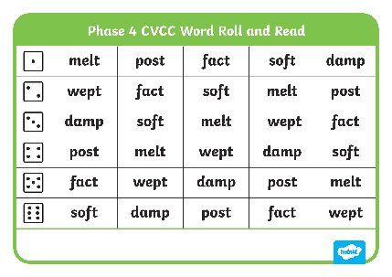
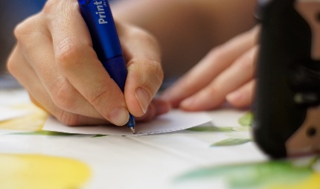
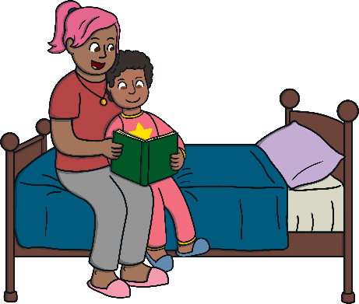
Helping Your Child at Home
play games
provide opportunities for writing
      provide opportunities for reading

Slide 21
How you can help at home.
Sing an alphabet song together
Play ‘I spy’
Praise your child for trying to segment and blend words
Learn the tricky words
Play phonic games
Play pairs with words and pictures

Slide 22
How you can help at home.
Phonics is not the only thing needed to become a fluent and competent reader!
Please continue to read with your child daily and encourage them to…
Sound out the words
Re-read the sentence to check it makes sense
Use the pictures to look for clues
Ask questions about the book and encourage your child to make predictions
Visit the library
Most importantly, enjoy reading!
Notes:
Sometimes it is difficult to hear your child read as we all live busy lives, but try to set aside 10 minutes each day to spend time sharing and reading their school book or a favourite book from home.
If your child doesn’t want to read, think about the environment around you. Is it a relaxed atmosphere? Are you or your child distracted by technology around you? This should be a precious time to enjoy and share books together.
Stay calm if your child is getting words wrong. Give them time to have a go but not too long, and say the word for them if they are struggling.

Slide 23
Resources
www.phonicsplay.com Lots of free games for each phase, especially good for reading non-words.
www.oxfordowl.co.uk/for-home Oxford Owls website
www.ictgames.com/literacy Wide range of games for sounds, words and rhyming.
www.topmarks.co.uk Search engine designed for school where you can find a wide range of resources and activities with a phonic focus.
YouTube clips:
Mr Thorne and Geraldine the Giraffe
Epic Phonics
Silly School Education phonics
Tricky Word songs Phase 2, 3, 4

