Slide 1

Welcome to Audley Infant
School
Year 1
Parent’s Meeting
September 2024

Slide 2
The Senior Leadership Team
Head teacher: Mrs H. Nelson
Deputy Head teacher: Mrs A. Diggle
Key Stage Lead: Mrs S. Massey
Year 1 Lead: Miss A Matlub

Slide 3
The Year 1 Team
Key Stage 1 Team Leader: Mrs S Massey
Year 1 Team Leader: Miss A. Matlub
Year 1 Aesop
Teacher: Miss A. Matlub
Year 1 Browne
Teacher: Mrs E. Taylor
Year 1 Jeffers
Teacher: Mrs B. Umerji
Teaching Assistants:
Miss Tudda
Mrs S. Yaqoob
Mrs Grunshaw

Slide 4
School Uniform and PE Uniform
Please label all clothes including your child’s PE kit and coat.
School Uniform:
PE Uniform:
PE kit includes white t-shirt, shorts (leggings acceptable) and black pumps. Please note, no tracksuit bottoms.

Slide 5
Attendance
In the line twenty-to-nine (8.40am)
Teachers come on to the enclosed playground at 8.40am and take the children in at 8.45am prompt.
If children arrive after 8:45am, they will be marked late. Persistently arriving late may result in meetings with the Head teacher and a possible fine.
School finishes at 3.15pm – your child must be collected promptly from the enclosed playground by a responsible adult (nobody under 14 is allowed to collect your child).
Excellent attendance is celebrated.

Slide 6
Attendance
How you can help your child:
Should your child need to be absent, this needs to be reported to the office at the earliest convenience.
Book appointments outside of school hours.
01254 52065

Slide 7
Dinner time
School dinners are free for all the children in the infants.
They have chosen their meals from the school menu. If you are unhappy with these, you can request a menu and select the meals with your child.
Packed lunches and school dinners cannot change in the week.

Slide 8
Behaviour Expectations
At Audley Infant School we pride ourselves on the excellent behaviour of our children.
What we expect:
Be respectful at all times.
Children must always use their manners e.g. saying ‘Please’ and ‘Thank-you’.
Make the right choices and take responsibility for their actions.
How we reward positive behaviour:
Classroom rewards e.g. stickers and team points.
Recognition by the Head-teacher including postcards being sent home.
Persistently challenging behaviour may result in the teacher and Head teacher meeting
with parents to discuss further.

Slide 9
The Year 1 Curriculum
The national curriculum sets out the programmes of study and attainment targets for all subjects at Key Stage 1 up to Key Stage 4.
All local-authority-maintained schools in England must teach these programmes of study.
At Audley Infant School we follow the national curriculum (2014). We are committed to the Excellence and Enjoyment agenda.

Slide 10


The Year 1 Curriculum
Phonics: A brief Outline
At the end of Year 1 (June), children will be expected to take a Phonics Screening Test in line with government guidance. The Phonics Screening Check tests their skills at word reading. This is sometimes called decoding.
At Audley Infant School, we use the Red Rose Phonics programme to support the teaching of phonics.
A further meeting on Reading and Phonics will be arranged for later in the year.

Slide 11
The Year 1 Curriculum
At Audley Infant School, we pride ourselves in our commitment to teaching excellence. Our high expectations ensure that children thrive in school.
Term | Topic
Autumn | Marvellous Me Amazing Animals
Spring | Brilliant Blackburn Transport
Summer | Mr. Bloom Wish you were here!
Each half term we will send home a topic map in your child’s homework book showing what we will be learning.

Slide 12
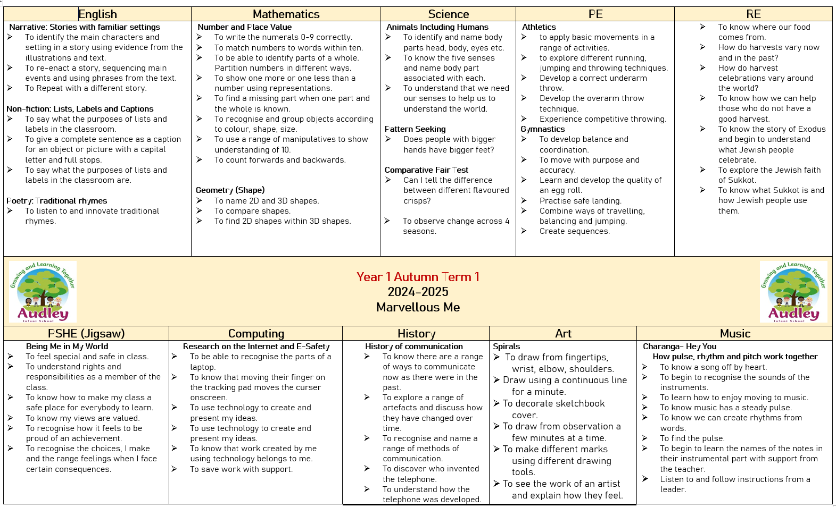

Slide 13
The Year 1 Curriculum
English Writing: A Brief Outline
What we will cover | How you can help
Spelling words with 40+ phonemes. Add prefixes and suffixes. Write simple sentences from memory. Orally say sentences. Sequence sentences to form short narratives. Use a range of punctuation. Use conjunctions. Capital letters for proper nouns. | Orally create a set of instructions. Retell stories and write some/parts of them. Complete all homework. Encourage children to use correct punctuation.
Some of the genres we will cover include: Instructions, Stories with familiar settings, stories from other cultures, poetry, traditional tales and fairytales, Recounts, Information, Fantasy and Memory writing.

Slide 14
The Year 1 Curriculum
English Reading: A Brief Outline (Word Reading)
There will be a separate meeting on our reading curriculum in addition to the information you receive today.
What we will cover | How you can help
Apply phonic knowledge to decode words. Read accurately by blending sounds in unfamiliar words. Read common exception words. Read words containing–s, –es, –ing, –ed, –er and –est endings. Read words with contractions Read books aloud, accurately, that are consistent with their developing phonic knowledge and reread these books to build up their fluency and confidence in word reading. | Strive for five! Re-read the same book to develop fluency Encourage blending words they cannot read

Slide 15
The Year 1 Curriculum
English Reading: A Brief Outline (Comprehension)
There will be a separate meeting on our reading curriculum in addition to the information you receive today.
What we will cover | How you can help
Listen to and discuss a wide range of poems, stories and non-fiction at a level beyond that at which they can read independently. Link what they read or hear to their own experiences becoming very familiar with key stories, fairy stories and traditional tales, learning to appreciate rhymes and poems, and to recite some by heart Predictions and inference. | Discuss the books they read. Encourage reading for pleasure. Ask questions about the book they are reading.

Slide 16
The Year 1 Curriculum
English Handwriting: A Brief Outline
At Audley Infant School we begin cursive writing from Reception. We use letter-join to support this progression through school.

Slide 17
The Year 1 Curriculum
Mathematics: A Brief Outline
What we will cover | How you can help
Number and Place value- read, write numbers to 100 from any given number, one more and one less. Addition and Subtraction- add and subtract 1 and 2-digit numbers to 20, interpret maths statements, solve word problems. Multiplication and division- solve 1-step word problems Fractions- recognize, find and name a half and a quarter. Measurement- solve practical problems for length, mass, height, capacity. Measure and record, value of different coins, dates, days of the week, time (hour and half the hour). | Practical word problems. Simple addition and subtraction using concrete material. Education city. Tell the time.

Slide 18
Reports
You will receive three reports this year to show you the progress that your child is making.
We assess children on a half-termly basis and this informs our planning and the support in place.
As well as summative assessment, we also formally assess our children to ensure they receive and respond to instant feedback.

Slide 19

Homework
We provide children with meaningful homework that supplements the things they are taught in school. Please support us in supporting your children by encouraging them to have a go independently.
Homework books are sent home every Friday and must be brought back into school on Wednesday.
We aim for children to read as much as possible. As well as their decodable book, they may also read other books, newspapers and magazines.
You may also wish to use maths programmes including Education City, Hit the Button and Nrich.

Slide 20
Parental Involvement
We at Audley Infant School would like to thank you for your commitment and willingness to support us in our mission to give children the best education and opportunities we possibly can.

