Slide 1

Welcome to Audley Infant School

Slide 2
Reminders
Please label all clothes (coats, jumpers etc.) and PE kits
Please make sure your child has a P.E. kit in school (black shorts or leggings, white T-shirt and black pumps).
No jewellery to be worn.

Slide 3

School timings
Excellent attendance is celebrated.
The teachers will come on to the enclosed playground at 8.40 ready to take the children into school at 8.45 prompt. You must stay with your child until the class teacher is at the front of the line
School finishes at 3.15pm – your child must be collected promptly from the enclosed playground by a responsible adult (nobody under 14 is allowed to collect your child)

Slide 4
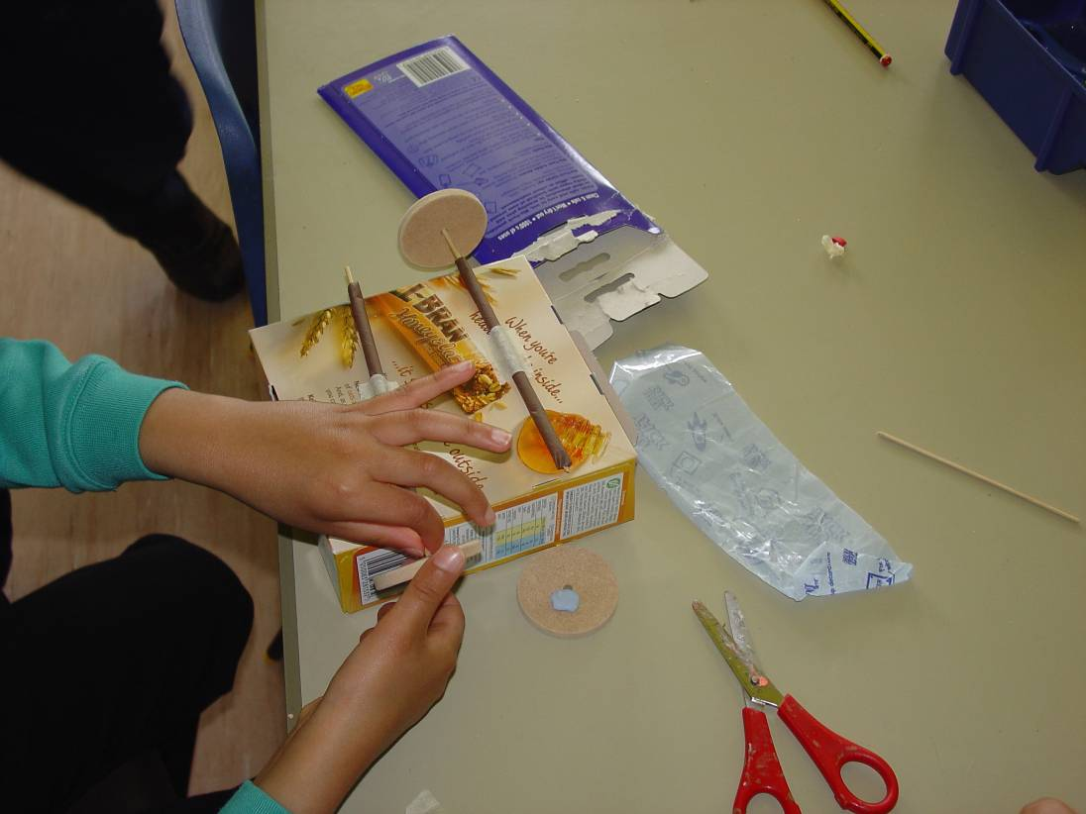
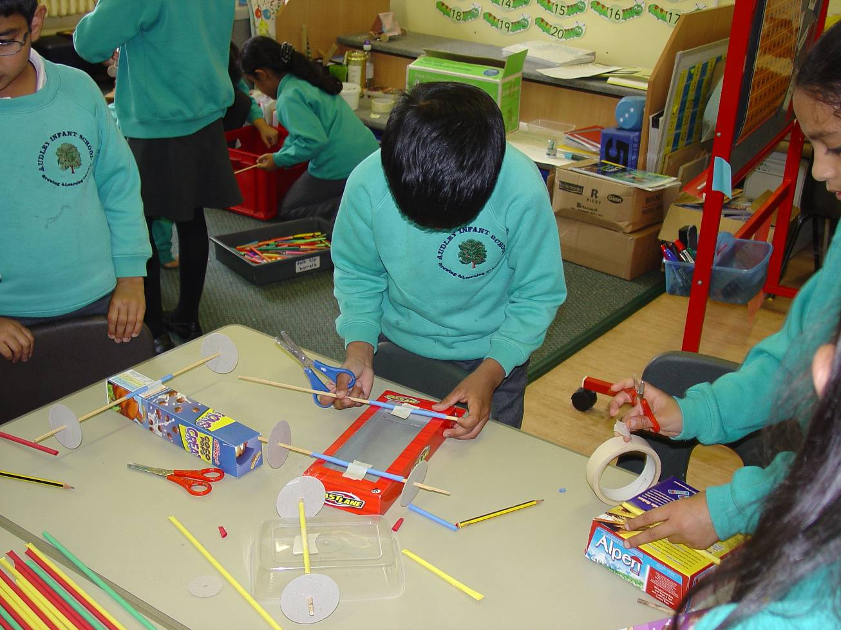
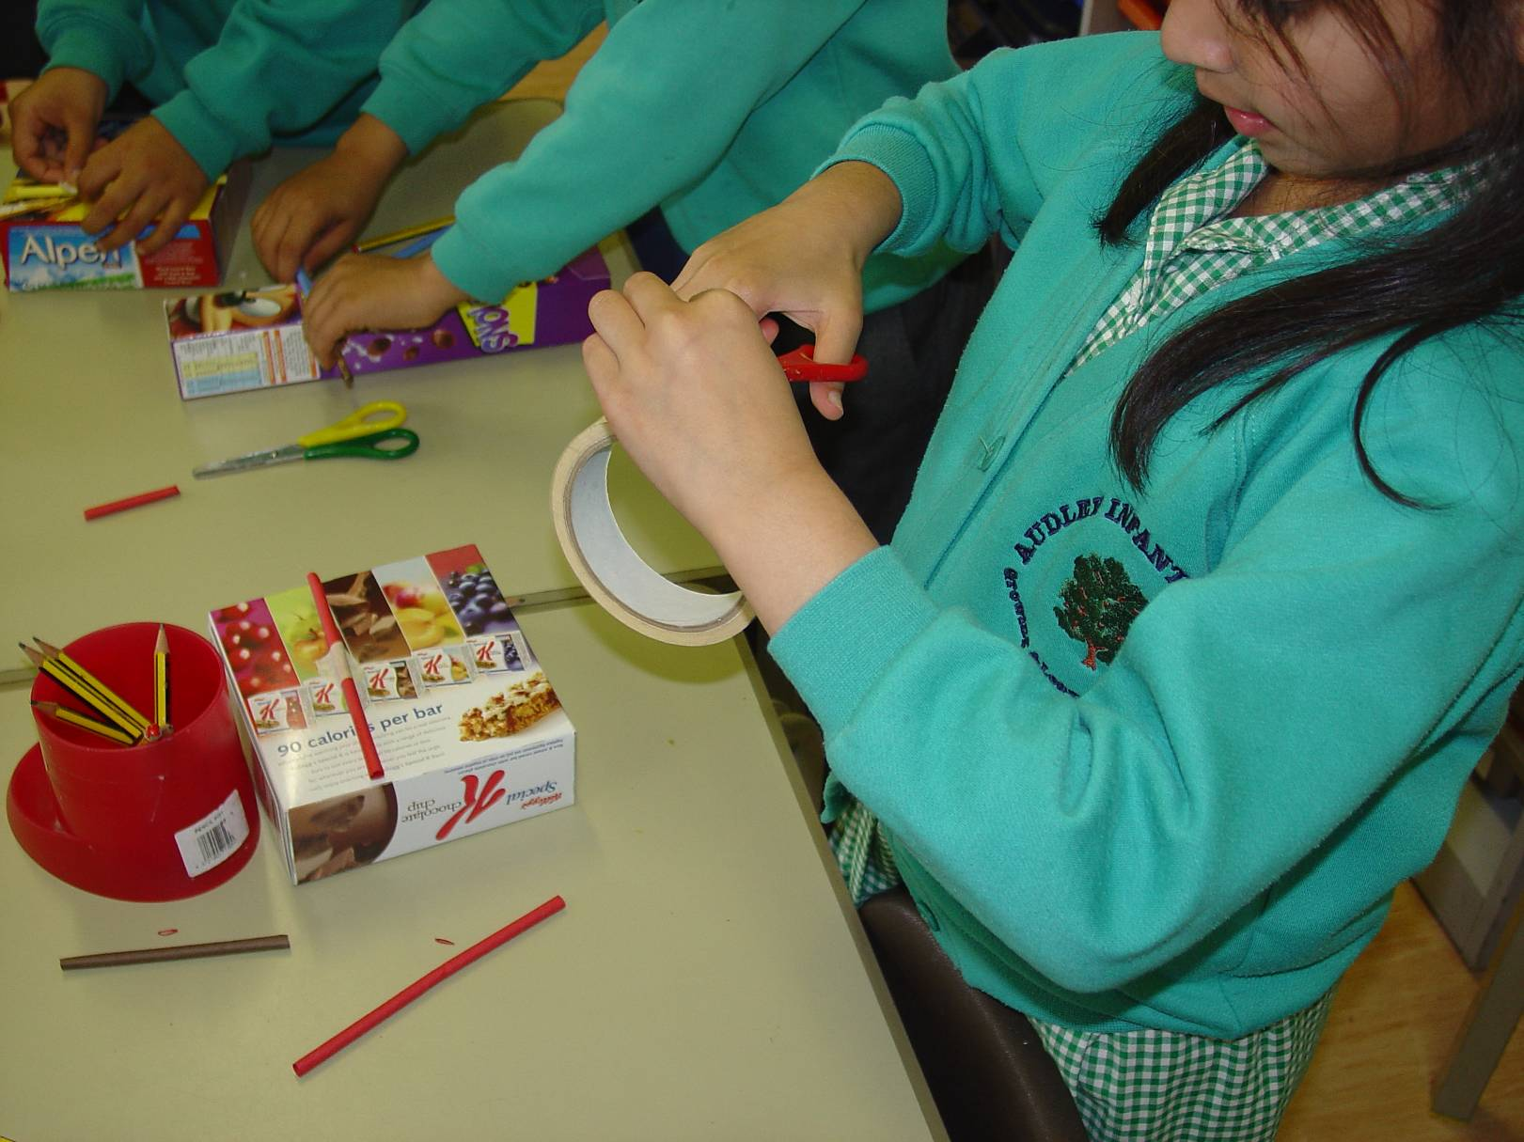
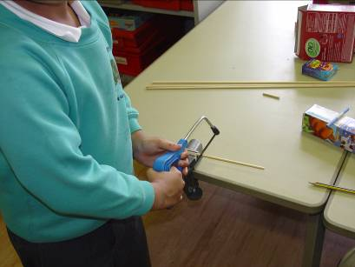
The Year Two curriculum
We work with the government’s statutory National Curriculum which came into effect from 2014
We give children experiences that enhance their learning by ensuring they have real hands on experiences
Visit places t
o help their learning
Enjoy well planned role play experiences

Slide 5
Topics
Our topics are:
Fighting Fit!
Fire! Fire!
Awesome Asia
Roar!
Castles
Park Life!
Each half term we will send home a topic map to show you what we will be learning.
Autumn Term
Spring Term
Summer Term

Slide 6
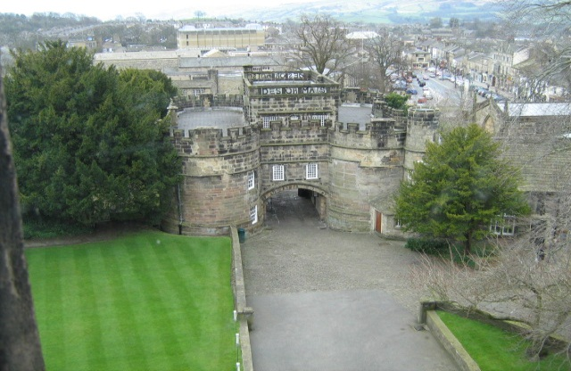
School Trips!
We visit Skipton Castle
We also have a theatre group coming next half term where the children will take part in acting out the events of the fire of London.
Other visitors:
Father Barry
Dentist
Firefighters

Slide 7
Information
During the year there will be opportunities for you to come into school and look at your child’s work
Please check your child’s reading bag daily for any important information, homework or spellings

Slide 8


Homework
Homework is sent home at the beginning of each half term. Choose one each week.
Please bring homework books back ready to be marked.
We will send it back home on Friday
Please work with your child through the homework activity but do not complete it for them!
Each child has their own log-in and password to access Developing Experts and Purple Mash which can be used to enhance classroom learning in a fun way!

Slide 9
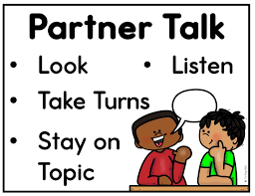

We no longer have fixed groups. Your child will complete their work in a variety of ways. Often in a mixed ability group or with a partner. Research has shown that this is more beneficial for all children and raises self-esteem.

Slide 10

Reading in Year 2

Slide 11

Reading
These are the skills that the government expect of your child at the end of the school year…
Read common words accurately
Read fluently and with expression
Use different strategies to read unfamiliar words eg sounding out, using pictures, using prior knowledge
Check their reading makes sense
Ask and answer questions, retell a story, find facts and predict
To explain how and why things are happening from what they already know

Slide 12
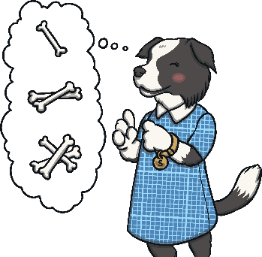

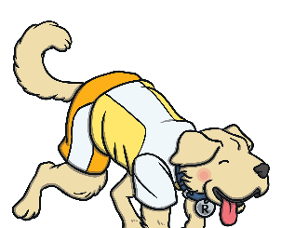


In KS1 reading, your child’s understanding of reading is tested through five different strands, known as ‘content domains’.
These content domains are:
Sequencing Suki
Content Domain 1c:
Identify and explain the order of events in texts.
Inference Iggy
Content Domain 1d:
Make inferences (guesses) from the text.
Think of reasons for why things happen.
Rex Retriever
Content Domain 1b:
Identify/explain key information in fiction and non-fiction texts such as characters, events and titles.
Predicting Pip
Content Domain 1e:
Predict what might happen on the basis of what has been read so far.
Vocabulary Victor
Content Domain 1a:
Draw on knowledge of what a word means to understand texts.
Notes:
Introduce parents and carers to the Year 2 SATs using the Totally Pawsome Gang to cover each content domain.

Slide 13
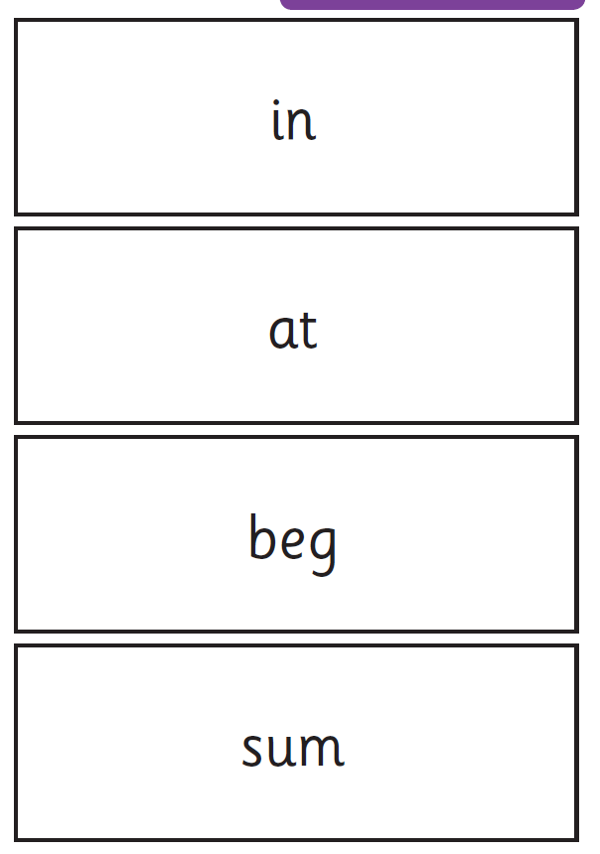
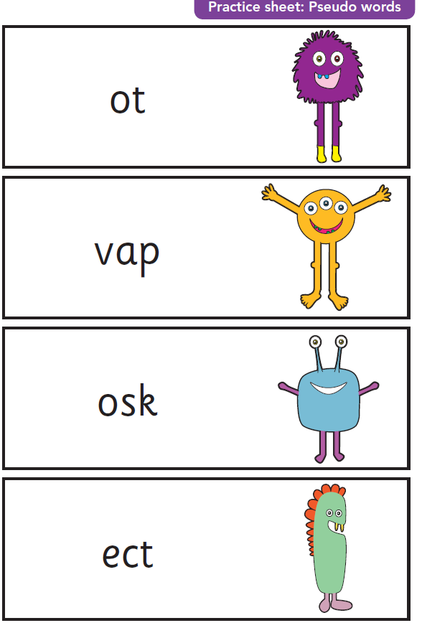
Phonics test
Any child who didn’t pass their phonics test in Year 1 will take part in daily phonic sessions and will resit the test in the summer term.

Slide 14

Reading
These are the ways we teach your child reading skills…
Sharing stories
With each other
With an adult
Go to the library
Reading with an adult
We will listen to your child read their home reading book each week and it will be changed when appropriate – when they can read it fluently and more importantly, talk about the book – answering questions like ‘how?’ and ‘why?’
Guided reading
Small group focused reading sessions with follow-up activities
Teaching of Reading
Whole class reading
At home read with them everyday!

Slide 15

Writing in year 2

Slide 16
This is how we assess your child. To reach each standard, your child must be able to do all the things listed.

Slide 17
So what do we look for in writing?
Sentences must make sense!
They must be grammatically correct.
They must have the correct punctuation – A . , ? ‘
Wow words – adjectives and adverbs (describing words)
Conjunctions – to join short sentences that are linked and make them more interesting (and, but, or)
to explain (when, and, if, that, because)
Tense is correct most of the time
Can spell many (42 or more) of the common exception words.(in homework books front and back).
Neat handwriting – letters formed correctly, same size, spaces between words
* The amount they write is not important if they do not have all the above in their writing!

Slide 18
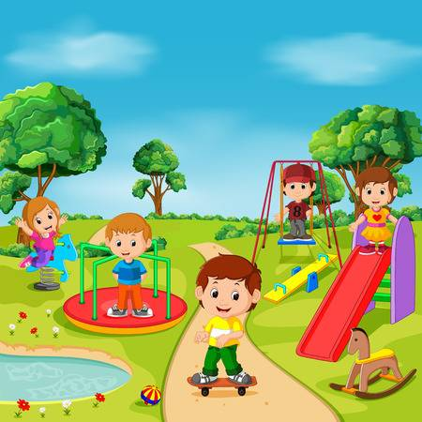
Can you make this sentence better?
The boy on skateboard
The boy is on a skateboard.
The young boy with the brown hair is extremely happy on a skateboard.
The young boy with the brown hair is extremely happy because he is on his new skateboard in the sunny park.

Slide 19

Handwriting
We use cursive handwriting where all letters start on the line. This has been proven to benefit children with dyslexia and to improve letter formation. It also helps with the joining flow – children will join their letters naturally when they are ready.

Slide 20

Maths
These are the skills that the government expect off your child at the end of the school year…
Partition 2 digit numbers into tens and ones
Add 2-digit numbers up to 100 eg 34+61
Subtract 2-digit numbers eg 65-24
Recognise inverse operations of addition and subtraction
Recall multiplication and division facts of the 2, 5 and 10 times tables
Identify 1/3, ¼, ½, 2/4 and ¾ of a number or a shape
Use different coins to make the same amount
Read scales eg weighing scale, thermometer, measuring jug and a ruler
Read time to the nearest fifteen minutes on a clock face, working towards learning the 5 minute interval
Describe properties of 2D and 3D shape using language such as sides, vertices and edges

Slide 21


Slide 22
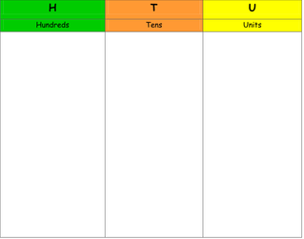
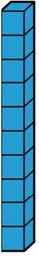

Concrete (Using base 10)
5
6

Slide 23
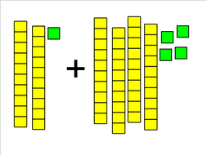
Concrete (Using base 10)
24 + 12 =

Slide 24
Pictorial (Using base 10)
56 = 5 tens 6 ones

Slide 25
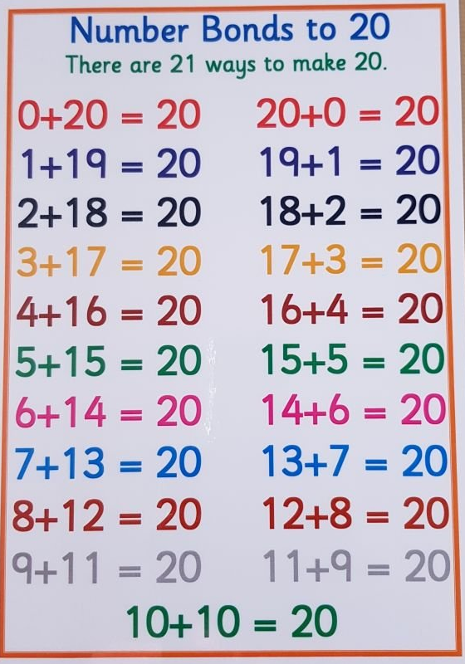
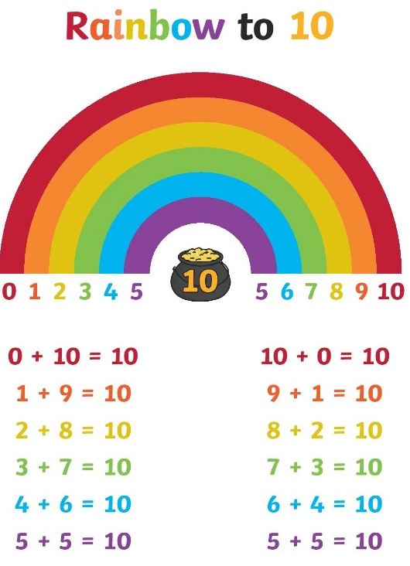
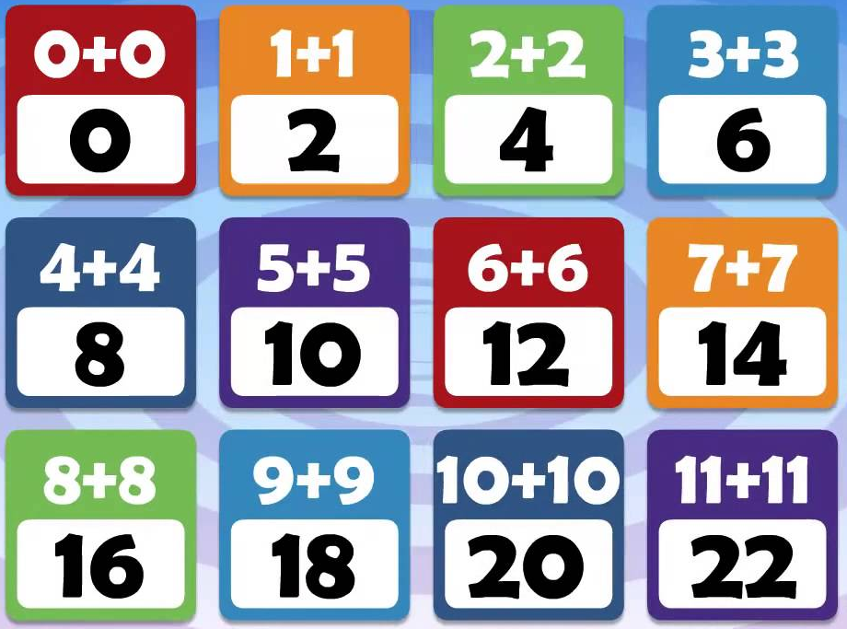
Number Facts (Mental recall)
Counting up to and through 100.
10 more and 10 less than a given number.
1 more and 1 less than a given number.
Number Bonds to 10 – related facts to 100.
Number Bonds to 20.
Doubles to 20- subsequent halves.

Slide 26
End of year tests (SATs) are no longer statutory.
We assess your child at the end of each half term using teacher assessments. This allows us to see if your child is working below, at or above the expected level.

Slide 27
Reports to parents
At the end of every term your child will bring home a short report about their progress and attitude to learning
In the Autumn and Spring terms there will be formal parents evenings where you can discuss your child’s progress and how best to help them in their learning.
A more formal report will be sent home at the end of the Summer term
You will be invited into class throughout the year for drop in sessions where you can look at your child’s work with them

Slide 28


We are looking forward to working with you all!!
You as parents are an important part of our Year Two team.

