Slide 1



BBC Children in Need
£

Slide 2
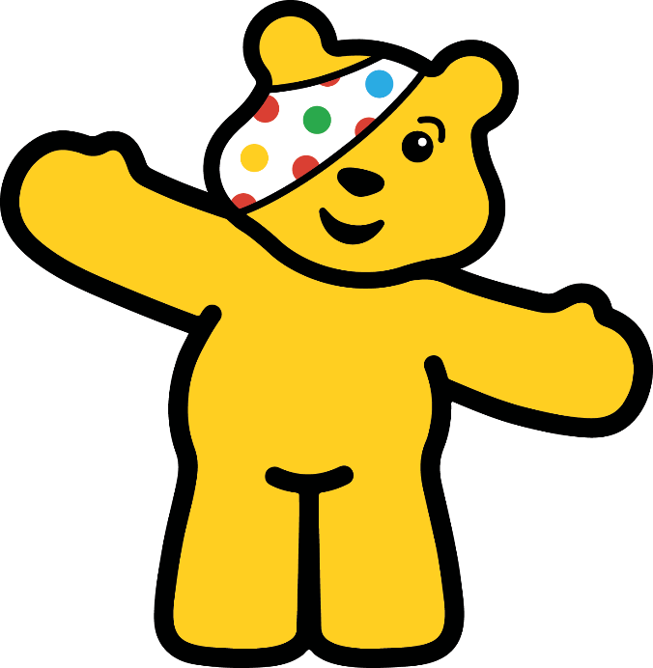
Hello Pudsey Bear!

Slide 3
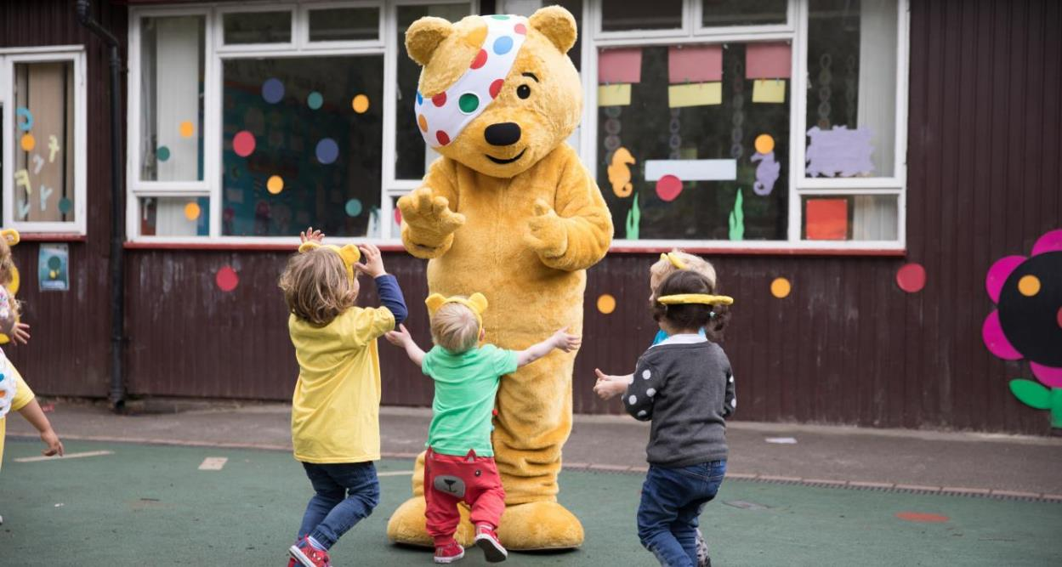
Pudsey Bear
Pudsey Bear is a very special friend to BBC Children in Need.
Pudsey Bear loves to see everyone having fun and helping to raise money.
Pudsey also loves spotty things!

Slide 4
What Does Being in Need Mean?
illness
poverty
disability
family

Slide 5
What Is BBC Children in Need?
a charity
main aims
television
November

Slide 6

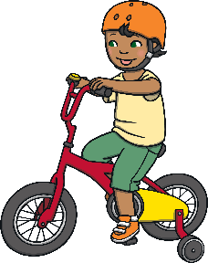

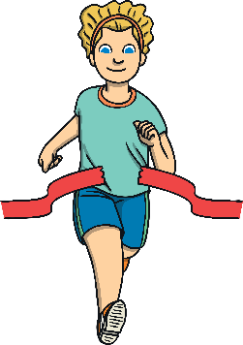


Raising Money for
BBC Children in Need
Many children’s lives have changed for the better thanks to BBC Children in Need.
People all over the UK raise money to help BBC Children in Need. People do lots of amazing challenges and fun events, such as:
wear fancy dress
have a cake sale
have a sponsored silence
take part in a race
set themselves a really hard challenge
have a dance-a-thon

Slide 7


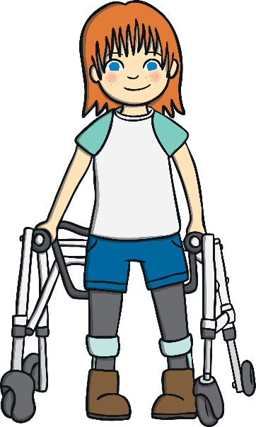

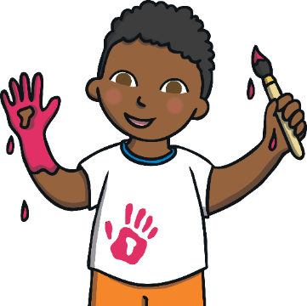
Where Does the Money Go?
BBC Children in Need collect all of the money that everyone has kindly donated.
They add the money up and let everyone know how much money they have raised. This money is all used to make children’s lives better and happier.

Slide 8
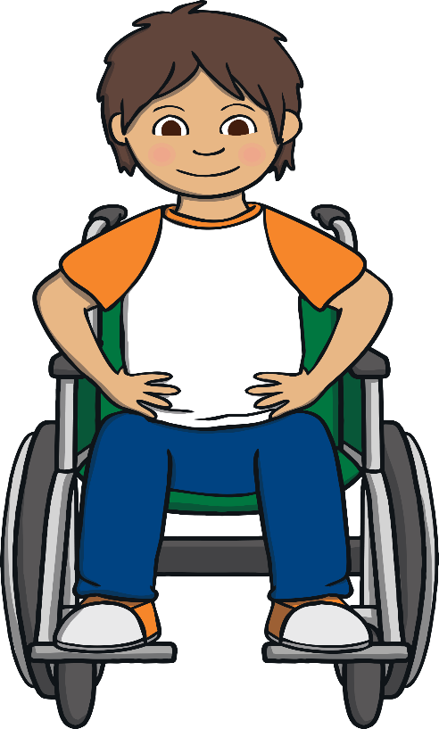
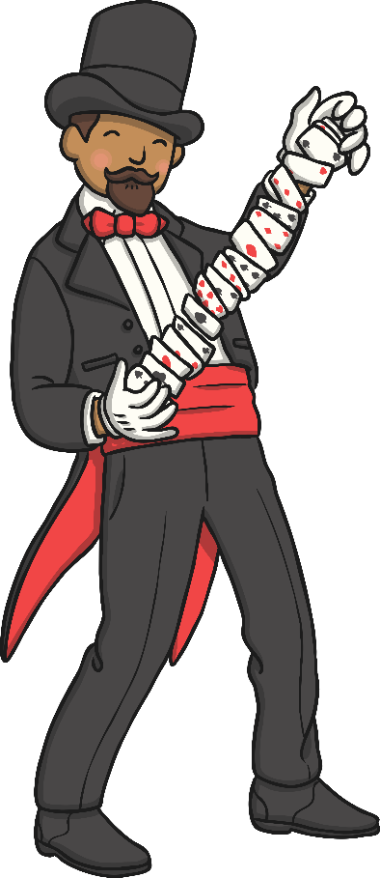
What Happens to the Money Raised?
Giving families support so that they can spend time together.
Giving children a safe place to play.
Enabling children to become involved in sports.
Arranging special events , such as magic shows , to let children laugh lots and make friends.
Buying equipment for those who need it, such as wheelchairs.

Slide 9

Now… let’s find out how much we’ve raised!
Amazing! Thank you for your support!

