Slide 1

Audley Infant School

Slide 2
Audley Infant School
Your child will now be a member of Audley Infant School which also incorporates the nursery provision.
The nursery class can cater for 30 children in the morning.
There are 3 reception classes this year.
Children move from reception to year 1 where there are 3 separate classes.
From year 1 children move to year 2, again
catered for in 3 classes.
Most children then apply to go to Audley Junior
School, but this is parental choice.

Slide 3
Welcome to Audley Nursery Class!
We would like to welcome your child and you to Audley Nursery class.
We are committed to providing your child with the best possible start to their learning journey at our school.
We believe every child is a unique child who will learn and develop in an enabling environment, with excellent teaching and support from adults. We will respond to their individual needs and interests and help them become happy confident resilient learners.

Slide 4
Our nursery has 2 teachers. Mrs Eckersley works Monday to Wednesday and Mrs Taylor works on Thursday and Friday. We also have three TLA’s, Mrs Ireland, Miss Hussain and Mrs Mahmood.
We are committed to investing in your child’s education and want them to have the very best possible start.
Our Staff
When children feel happy and secure, they are confident to explore and to try out new things. It is important that they see
that you feel happy and confident with us too.
It is important that you share information about your child with us. We have bilingual staff who can speak Urdu and Punjabi.

Slide 5
Partnership between home and school.
Good communication is essential
We will work together to provide the best possible start for your child
We recognise that you are the first educator of your child
We value everyone equally
We are always here to help should you need us

Slide 6
Keeping in touch – Evidence Me
In nursery we use Evidence me to capture your child’s learning journey with us. We make observations and take photographs which will be emailed to you. You need to make sure we have the correct email address for you, and accept the invitation before we can send anything to you.

Slide 7
The Early Years Foundation Stage
There are three prime areas of learning:-
personal, social and emotional development
physical development
communication and language
There are also four specific areas of learning:-
literacy
mathematics
understanding the world
expressive arts and design

Slide 8
A day at Audley Infant Nursery Class

Slide 9
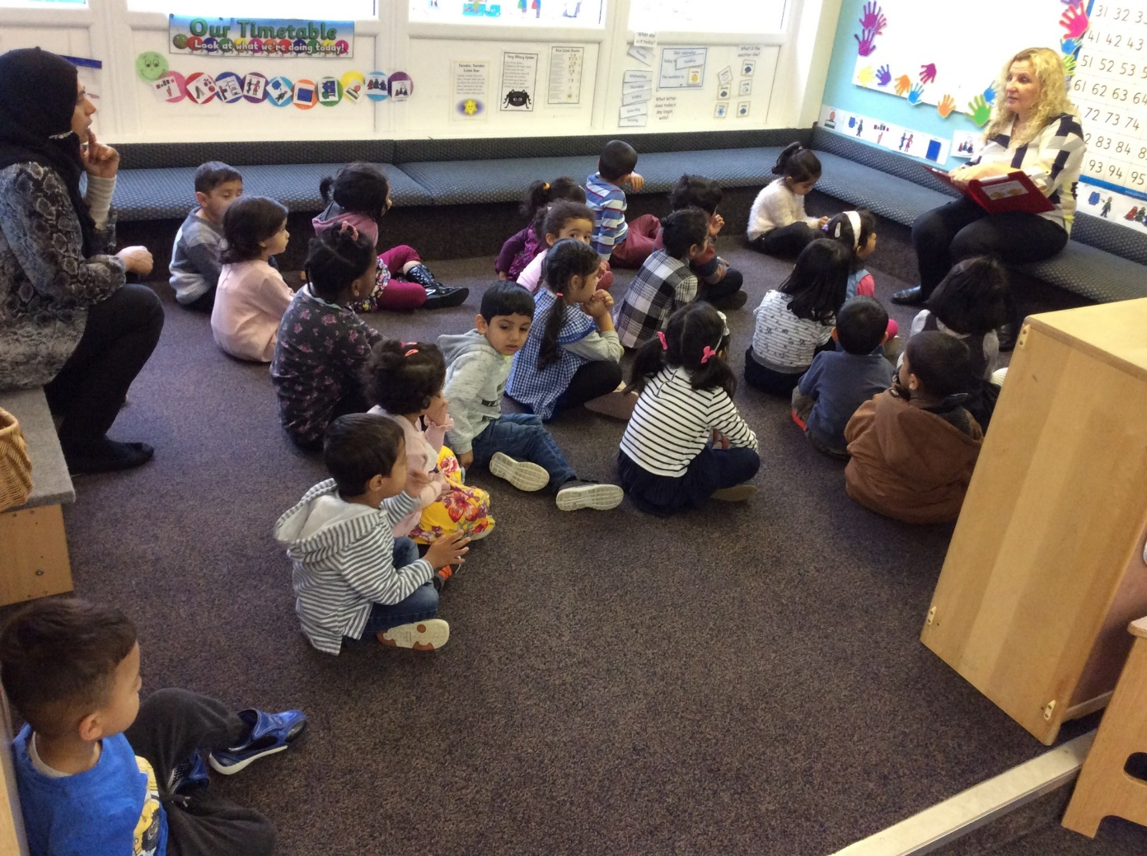
Nursery Routine
8:50 am – Doors open
9:05 am – Wake and Shake
– Register
– Carpet session- story/rhymes/number time
9:30 am – Group time
9.50am -- Continuous provision
10:30 am – Outdoor play
11:30 am – Tidy up time
11:40 am – Carpet time
11:50 am – Doors open

Slide 10
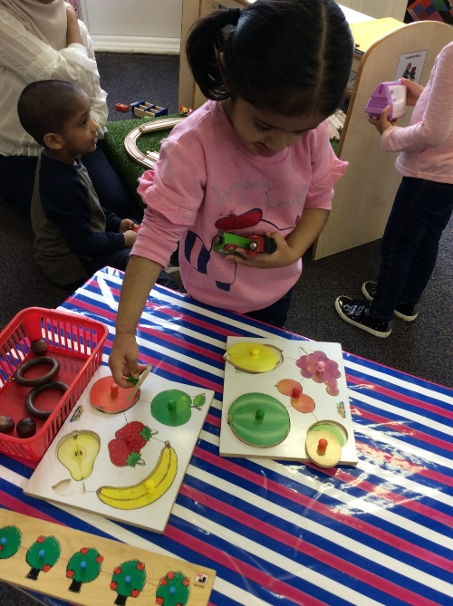
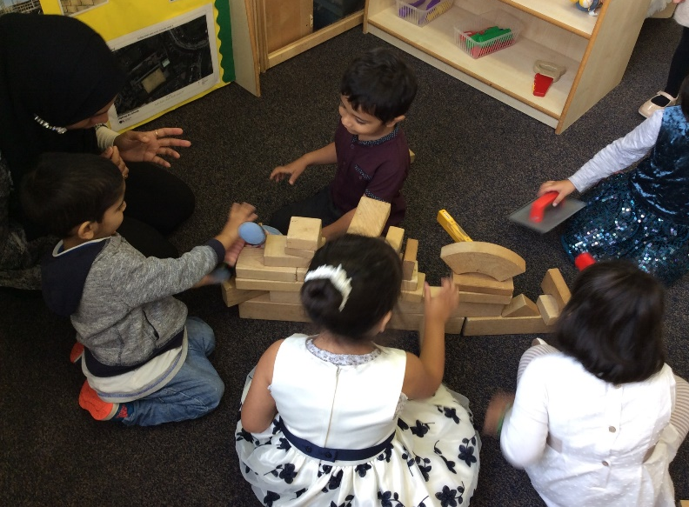
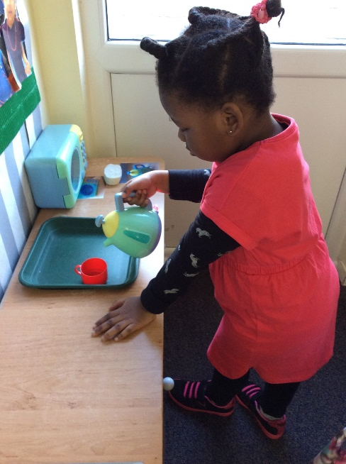
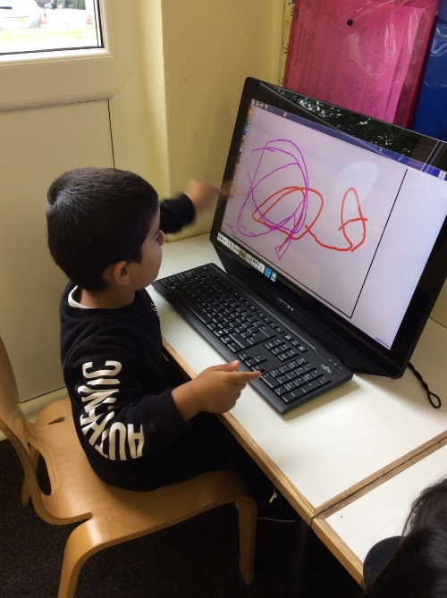
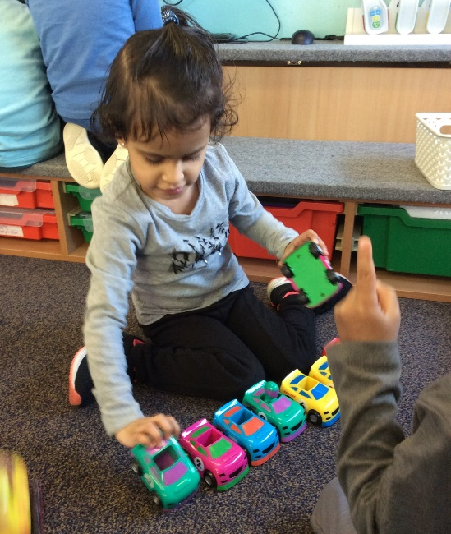
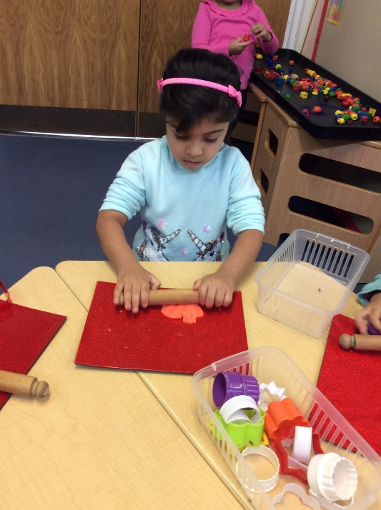
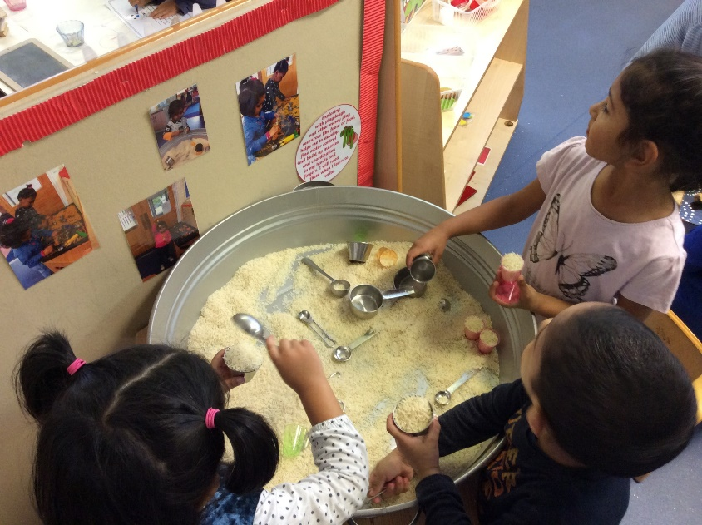
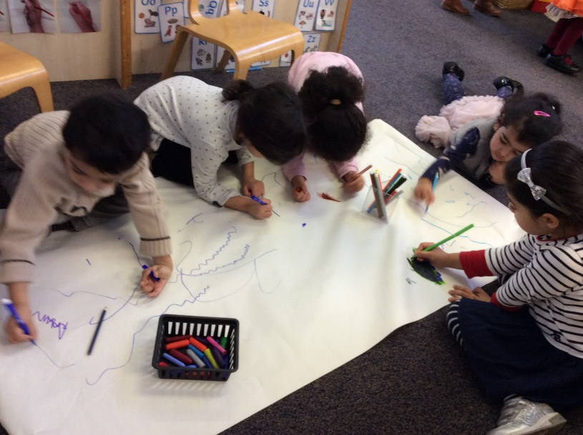
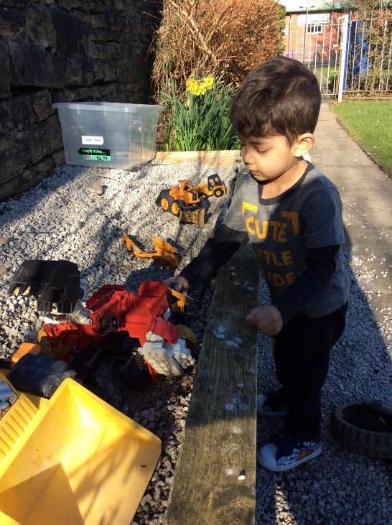
Continuous Provision Activities
Continuous provision offers children the opportunity to learn through carefully planned play activities. Play is essential for children’s development, building confidence as they learn to explore.

Slide 11
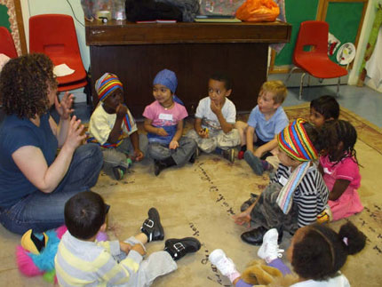
Group time
Group time activities – Your child will take part in small group activities everyday. These will be focussing on -
      Feelings and emotions
      Mathematics
      Speaking and listening
      Letters and sounds – early phonics

Slide 12
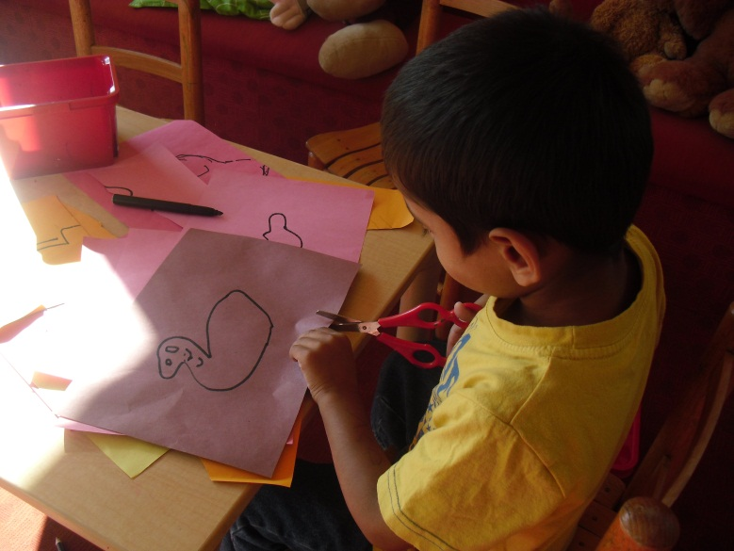
Observation and planning
The staff will observe your child at play and then plan activities during the week which are tailored to meet your child’s individual needs.
This ensures that your child is learning and developing by doing things they are interested in and will enjoy. There will be a strong focus on communication and language. Your child will have a number of quality conversations daily in a language rich environment.

Slide 13
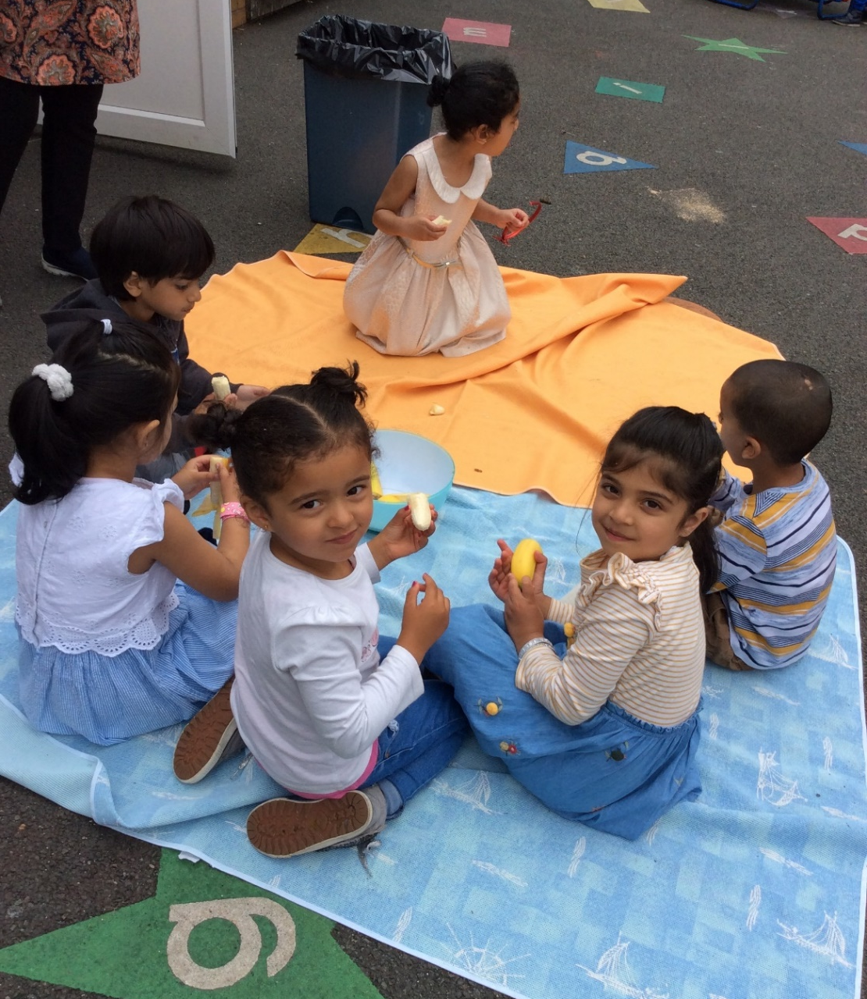
Snack
Snack is available to the children throughout the session daily. The children can access snack as and when they wish.
Snack consists of healthy fruit and vegetables.
Milk and water is offered daily.
Water is available throughout the
morning.

Slide 14


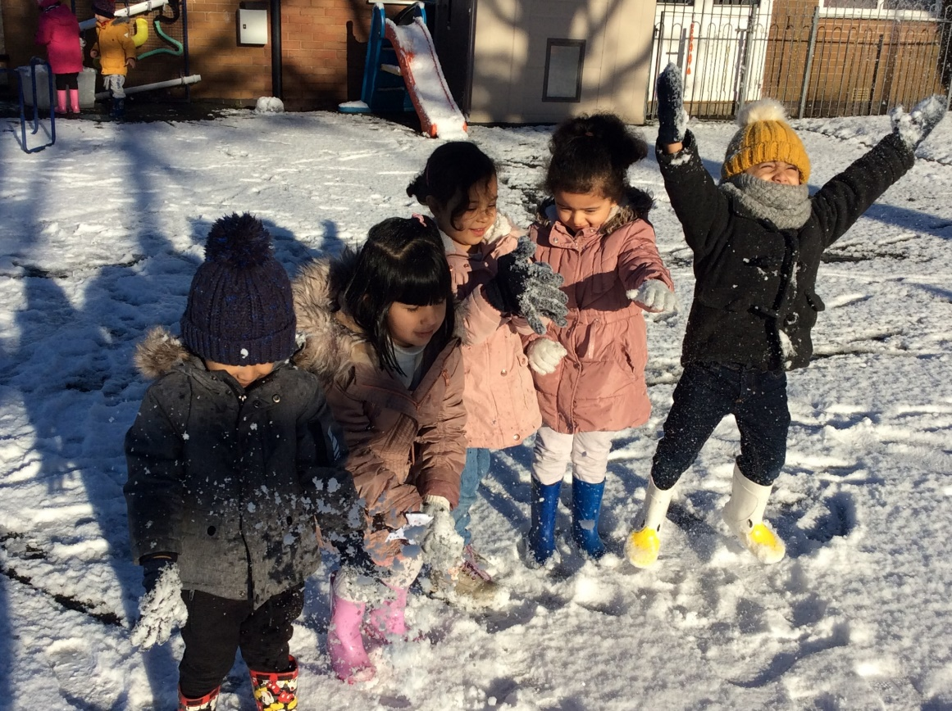
Outdoor play
EYFS states we must give the children access to outdoor play daily regardless of the weather
All the children must have the choice of playing outside on a daily basis
The learning opportunities when playing outside are endless.
Please can you make sure your child has a warm coat, gloves, hat and if possible wellies in nursery each day in cold weather and sun hats and sensible shoes in warm weather.

Slide 15

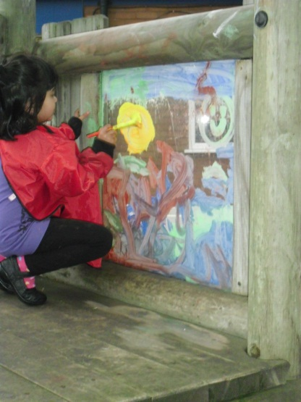
Essentials
As the children often get very messy we recommend that they only wear old clothes for their session.
Please can all your child’s clothes be labelled with their full name.

Slide 16

How can you support your child’s learning in their nursery year?
Please try and toilet train your child over Summer. Encourage independence e.g. when toileting & dressing. Teach your child routines of hand washing before eating and after going to the toilet, & brushing their teeth twice a day .
Encourage your child to listen to you by asking them to look at you as you talk together. Make sure you listen to them as they talk too. Read stories to them and sing nursery rhymes with your child.
Encourage your child to put things away when they have played with them and to tidy up with you at the end of play. Tidying can be a fun game – get your child involved.

Slide 17
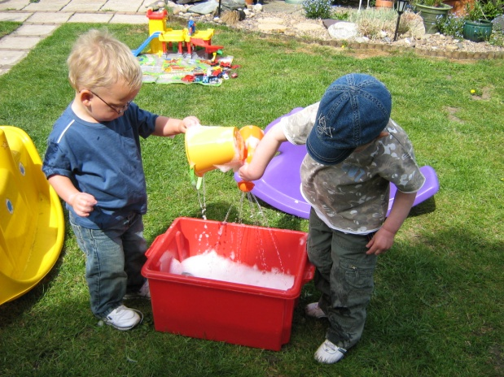
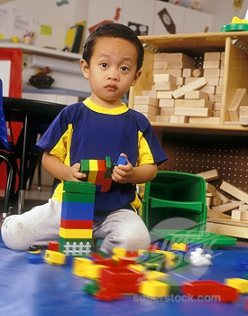
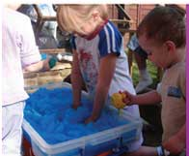

It is good for your child to explore and try a range of practical activities at home such as water play, baking, pretend play and play doh. Read books to them and sing songs and rhymes.
If your child shows an interest in writing their name please support them learning only to use a capital at the beginning. Allow them to learn to squiggel & draw before writing letters. Try writing in mud, paint or foam before using a pencil
If your child shows an interest in the alphabet help them learn letter sounds rather than the way letters are in the alphabet song. Staff can help you if you are unsure what sounds the letters make.

Slide 18
Nursery session times
Please be on time!!
Our session starts promptly at 9:00 am. Doors will be open from 8.50am.
Our session finishes at 12:00pm. Doors will be open from 11.50am.
Children take part in Wake and Shake at the beginning of every session. We then have register time and an important carpet session which might be counting, phonic songs, rhymes or a story. It’s important to get your child in on time then they don’t miss any learning.
Please collect your child on time at the end of a session.
Thank you for your co-operation.

