Slide 1


Asthma Friendly Schools
Information for Parents
Notes:
Hello and welcome to todays session on asthma.

Slide 2


Aim of Asthma Friendly Schools Project
To ensure the safety of young people with asthma in school.
To enable schools and settings to achieve a set of quality standards for asthma care.
Notes:
Asthma is the most common childhood chronic illness. Unfortunately asthma can cause death if not managed or recognized in timely manner, and most of these deaths are preventable with the correct treatment and management.
The objects of the asthma friendly schools project are - To ensure the safety of young people with asthma in school.

Slide 3
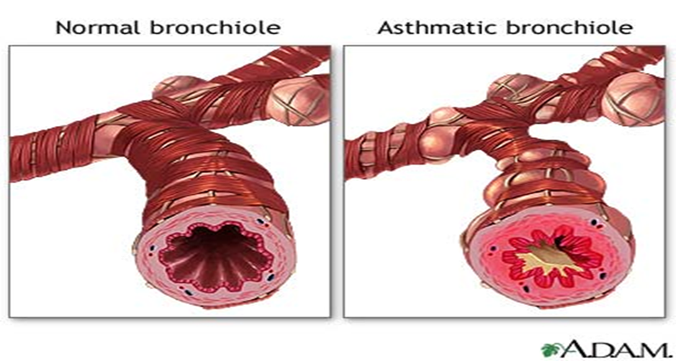
What is asthma?
When young people with asthma come into contact with a trigger, the muscles around their airways become tight and the lining of the airways becomes swollen and inflamed.
This causes narrowing of the air passage.
The development of mucus or phlegm further reduces the airway and the young person’s ability to move air in and out of the lungs, therefore making it difficult to breathe.
Notes:
When a child with asthma comes into contact with a trigger that affects their asthma the airways do 3 things:-
Swelling of airway
Narrowing of the airway
Production of mucus

Slide 4







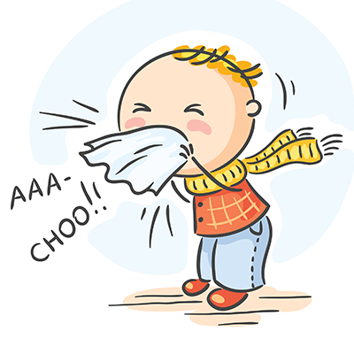







Triggers
 | POLLEN |  | EXERCISE |  | HOUSE DUST MITE
 | POLLUTION |  | MOULDS |  | PERFUME
 | SMOKING |  | COLDS & VIRUSES |  | DUST FROM FLOUR
 | CHEMICALS |  | PAINTS |  | SOME FOODS
 | STRESS & EMOTIONS |  | FEATHERS |  | ANIMALS
Notes:
Here are some common triggers. The most common tend to be pollen, exercise and smoking.

Slide 5
Asthma Symptoms
Asthma is a very common long-term lung condition.
People with asthma often have sensitive, inflamed airways. They can get symptoms like coughing, wheezing, feeling breathless or a tight chest.
Asthma symptoms can come and go. Sometimes people may not have symptoms for weeks or months at a time.
Asthma needs to be treated every day, even if you feel well, to lower the risk of symptoms and asthma attacks.
Notes:
Children can get symptoms like coughing, wheezing, feeling breathless or a tight chest.
Asthma symptoms can come and go. Asthma needs to be treated every day, even if you feel well, to lower the risk of asthma attacks.

Slide 6
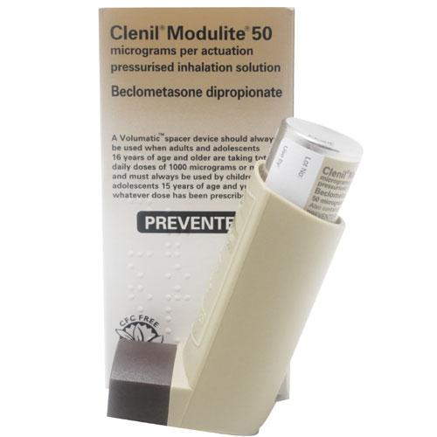
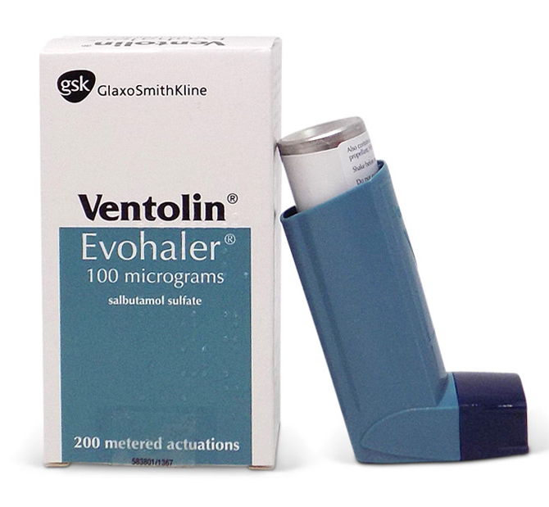
What treatment will your child need?
PREVENTER
RELIEVER
Notes:
The most common preventive inhalers are the brown inhaler which is called Clenil.
The most common reliever inhaler is blue inhaler called salbutamol.
ALL INHALERS SHOULD ALWAYS BE TAKEN WITH A SPACER no matter what the age of your child.
Every child should have a salbutamol inhaler and spacer in school.

Slide 7
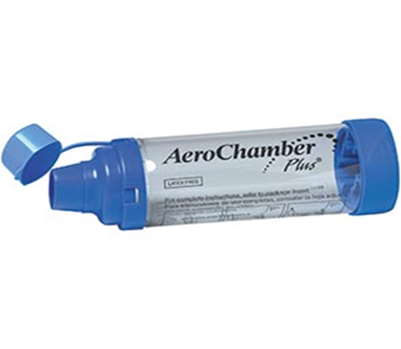
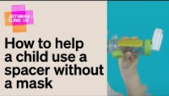


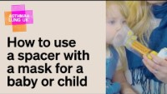
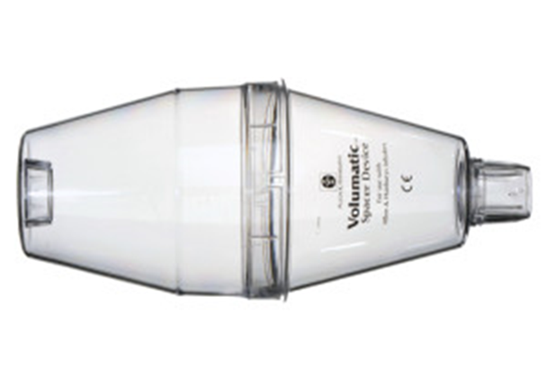
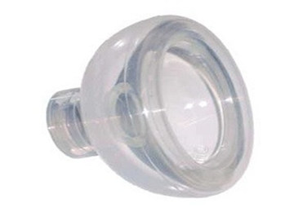
Spacer and Inhaler Techniques
Notes:
Here are a few different types of spacer devices. Spacer devices should be changed annually. You can ask your dr for more than one spacer device to allow one in school and one at home.

Slide 8

Demonstration of inhaler technique
How to use a spacer with tidal breathing | Asthma + Lung UK (asthmaandlung.org.uk)
Notes:
Please click on the link to see how to use a spacer with tidal breathing.

Slide 9



Their dry powdered device may look like this…..
You don’t need to use a spacer with these devices, but it is important to know how to use them properly
Notes:
Someone child may be prescribed a dry powdered device which may look like this. You don’t need to use a spacer with these devices.

Slide 10
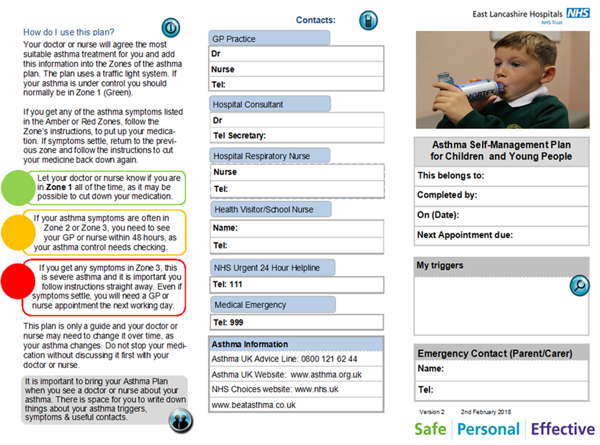
Personalised Asthma Action Plan
Their Asthma Plan might look like this…
Notes:
Every child need to have an updated individualised asthma action plan which will look like this. These are obtained via your GP surgery. The asthma action plan should be reviewed on an annual basis or if your child has an asthma attack.

Slide 11

Digital Health Passport
Young people who have a mobile phone may want to download the Digital Health Passport.
It is an App for children and young people with long term health conditions like asthma.
It helps both you and them monitor their symptoms, gives information and advice and can even remind them to take their medication.
You can also upload a copy of your child’s Personalised Asthma Action Plan so that they can show your doctor / nurse / teacher when needed.
Notes:
We encourage all young people who have access to a mobile device to download the digital health passport. This is an app to help young people manage their asthma effectively.

Slide 12
How you can support us…
Ensure your child has a Personalised Asthma Action Plan and that this is shared with school.
Ensure your child has their reliever and spacer in school, that it is in date and replaced when needed.
Ensure you have given consent for your child to use the school emergency inhaler if required.
Ensure your child takes their preventer medication every day as prescribed, using the correct technique (even if they seem well).
You can contact your GP /Practice Nurse / School Nurse for further advice and support around your child’s asthma.
Keep up to date with your childs annual asthma review.
Notes:
How can you help support your childs asthma in a school setting?
Ensure your child has a Personalised Asthma Action Plan and that this is shared with school
Ensure your child has their reliever and spacer in school
Ensure you have given consent for your child to use the school emergency inhaler if required.
Ensure your child takes their preventer medication every day as prescribed
Keep up to date with your childs annual asthma review.

Slide 13
Additional Training And Resources
Supporting Children's Health and Young People with Asthma (educationforhealth.org) – Tier 1 training
Asthma Lung UK - Asthma + Lung UK (asthmaandlung.org.uk)
Monkey Wellbeing - Asthma - Monkey Wellbeing
Notes:
We encourage all parents or guardians to complete the Tier 1 training which can be accessed via the link to further your knowledge
Asthma Lung UK also offers lots of resources and information regarding asthma management
Monkey wellbeing again is another online information platform were you can seek further information

Slide 14

Thank you for listening!!
Notes:
Thankyou for listening.

