Slide 1


Asthma Friendly Schools
Information for Parents
Notes:
Hello and welcome to todays session which is going to provide you with information regarding the asthma management training as part of the asthma friendly schools project.

Slide 2
Aim of Asthma Friendly Schools Project
To ensure the safety of young people with asthma in school.
To enable schools and settings to achieve a set of quality standards for asthma care.
Notes:
So why do we need to manage asthma in school effectively.
Well as well asthma is the most common childhood chronic illness, with approximately 1/11 children having asthma, that’s equates to 2-3 children per average class. Unfortunately asthma can cause death if not managed or recognized in timely manner, and most of these deaths are preventable with the correct treatment and management.
The objective of the asthma friendly schools project are:
1. To enable schools and settings to achieve a set of quality standards for asthma care.
2. To ensure the safety of young people with asthma in school.

Slide 3
What are our goals?
Achieve a standardised approach to asthma management in schools.
Less school days missed due to asthma.
Less hospital presentation due to poor management of asthma.
To understand the incidence of asthma and care requirements for your school setting.
Increased knowledge and confidence for staff in managing asthma in school
Increased knowledge and clear support for students.
Increased knowledge and confidence for parents.
Notes:
The goals of the asthma friendly schools project are….

Slide 4
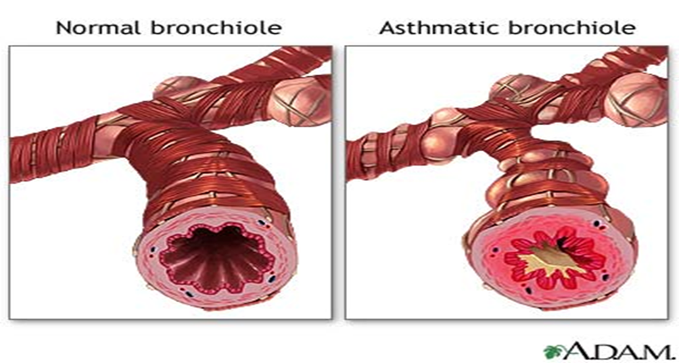
What is asthma?
Asthma is a long term health condition that affects the airways
It affects 1 in 12 adults and 1 in 11 children/young people - that is 2-3 students in each class.
When young people with asthma come into contact with a trigger, the muscles around their airways become tight and the lining of the airways becomes swollen and inflamed.
This causes narrowing of the air passage (imagine the diameter of a hose pipe reducing to a straw).
The development of mucus or phlegm further reduces the airway and the young person’s ability to move air in and out of the lungs, therefore making it difficult to breathe.
Notes:
When a child with asthma comes into contact with a trigger that affects their asthma the airways do 3 things:-
The lining of the airways becomes inflamed and starts to swell
The muscle around the walls of the airways tighten so that the airway becomes narrower
Production of sticky mucus/phlegm (sounds like flem) leading to further narrowing and irritation
Asthma and Lung UK liken the narrowing from a hose pipe to a straw

Slide 5







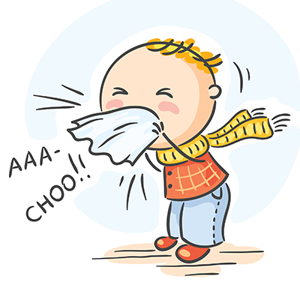







Triggers
 | POLLEN |  | EXERCISE |  | HOUSE DUST MITE
 | POLLUTION |  | MOULDS |  | PERFUME
 | SMOKING |  | COLDS & VIRUSES |  | DUST FROM FLOUR
 | CHEMICALS |  | PAINTS |  | SOME FOODS
 | STRESS & EMOTIONS |  | FEATHERS |  | ANIMALS
Notes:
Here are some common triggers. The most common tend to be pollen, exercise and smoking. This list is not exhaustive.

Slide 6
Asthma Symptoms
Asthma is a very common long-term lung condition.
People with asthma often have sensitive, inflamed airways. They can get symptoms like coughing, wheezing, feeling breathless or a tight chest.
Asthma symptoms can come and go. Sometimes people may not have symptoms for weeks or months at a time.
Asthma needs to be treated every day, even if you feel well, to lower the risk of symptoms and asthma attacks.
Notes:
People with asthma often have sensitive, inflamed airways. They can get symptoms like coughing, wheezing, feeling breathless or a tight chest.
Asthma symptoms can come and go. Sometimes people may not have symptoms for weeks or months at a time.
Asthma needs to be treated every day, even if you feel well, to lower the risk of symptoms and asthma attacks.

Slide 7
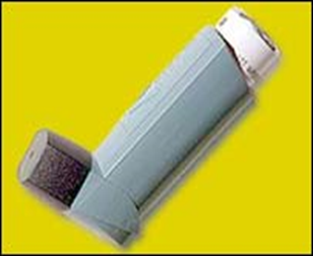
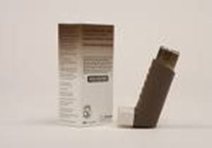

What treatment will your child need?
Most young people with asthma take inhalers. They may also take tablets or granules.
There are 2 types of inhaler:
CONTROLLER/PREVENTER IINHALERS stop asthma symptoms like coughing & wheezing happening.
They need to be taken every day, even if your child feels well and their breathing is fine.
They are normally brown or purple.
EMERGENCY/RELIEVER INHALERS work to make asthma symptoms like coughing & wheezing better.
They should only be taken when needed eg: if your child is coughing, wheezing or finding it difficult to breathe.
They are normally blue.
ALL INHALERS SHOULD ALWAYS BE TAKEN WITH A SPACER, unless your child is using a dry powdered device. Your doctor or asthma nurse will tell you if this is the case and it should be stated on their asthma plan.
Older children should always have their reliever inhaler and spacer with them in school (in their bag or blazer pocket) and know who to go to for help if they feel unwell. Younger children should know where their inhaler and spacer are kept, and also know who to go to for help.
Notes:
So now we are going to explain the difference between a controller/preventer inhaler and a emergency/reliever inhaler.
The most common controller/preventive inhalers are the brown inhaler which is called Clenil. Most children with take this everyday morning and night. Please be advised by your child’s asthma action plan. It is importance to be aware controller/preventative inhaler needs to be taken regularly even if you don’t have symptoms, as this reduces the inflammation and sensitivity of your airways.
Everyone with asthma needs a emergency/reliever inhaler (this is usually blue and is called salbutamol) for quick relief when their symptoms come on. Your emergency/reliever inhaler works quickly to relax the muscles in your airways so you can breathe more easily.
ALL INHALERS SHOULD ALWAYS BE TAKEN WITH A SPACER no what the age of your child, unless your child is using a dry powdered device.
Older children should always have their emergency/reliever inhaler and spacer with them in school (in their bag or blazer pocket) and know who to go to for help if they feel unwell. Younger children should know where their inhaler and spacer are kept, and also know who to go to for help.

Slide 8
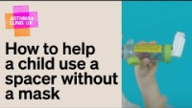
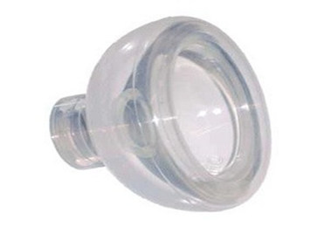
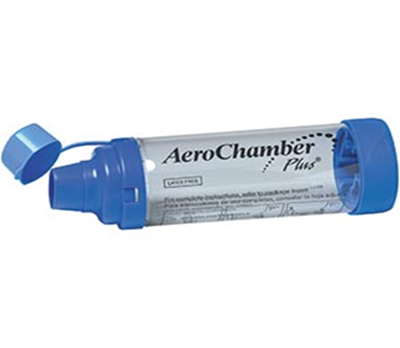
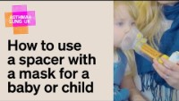
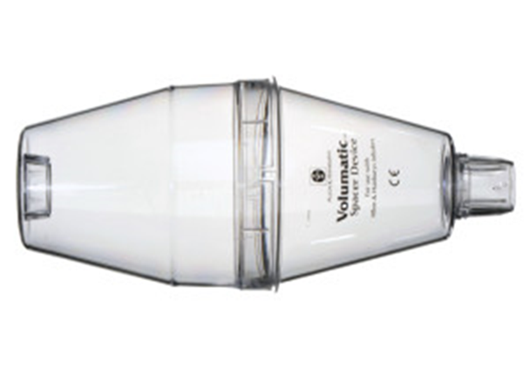

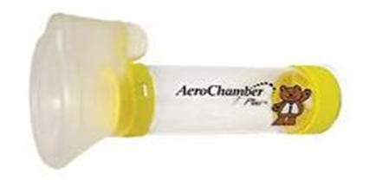
Spacer and Inhaler Techniques
Notes:
Here are a few different types of spacer devices. Spacer devices should be changed annually. You can ask your dr for more than one spacer device to allow one in school and one at home.

Slide 9

Demonstration of inhaler technique
How to use a spacer with tidal breathing | Asthma + Lung UK (asthmaandlung.org.uk)
Notes:
Please click on the link to what how to use a spacer with tidal breathing.

Slide 10



Their dry powdered device may look like this…..
You don’t need to use a spacer with these devices, but it is important to know how to use them properly
Notes:
Someone child may be prescribed a dry powdered device which may look like this. You don’t need to use a spacer with these devices, but it is important to know how to use them properly. You can find lots of demonstration vidoes on the Asthma and Lung UK website.

Slide 11
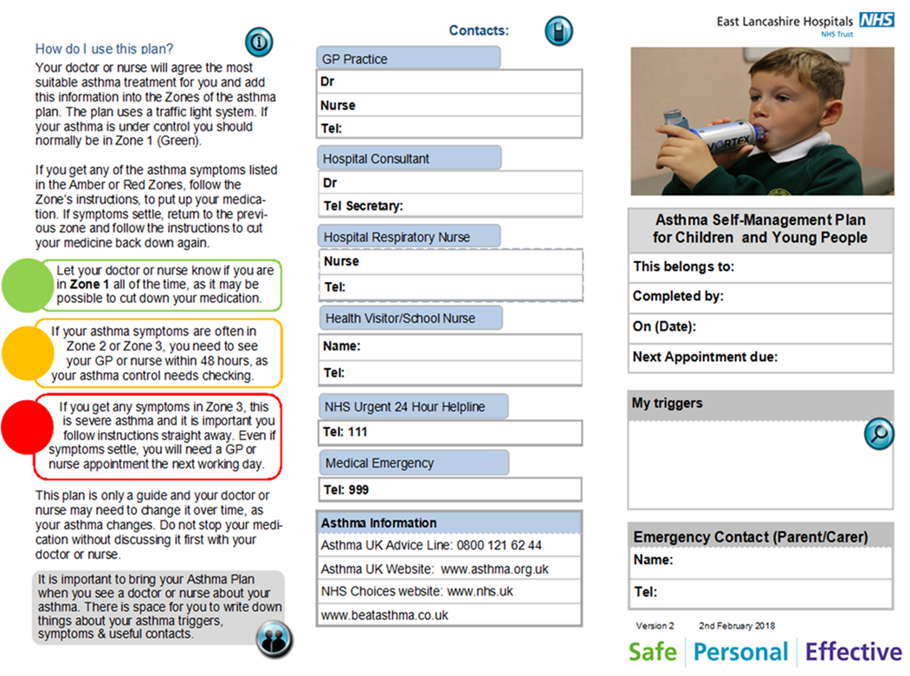
Their Asthma Plan might look like this…
Notes:
Every child need to have an updated individualised asthma action plan which will look like this. These are obtained via your GP surgery. You can either see the GP or practice nurse. The asthma action plan should be reviewed on an annual basis during your child's asthma review or if your child has an asthma attack.
Don’t be confused with the wheeze step down plan which you may be provided with in a&e.

Slide 12


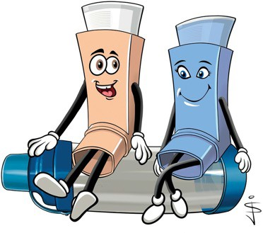
Remember: take your blue inhaler before you come into contact with any of your triggers if needed and regularly in response to symptoms if you have a cold.
Your Asthma Nurse’s name and telephone number is:
My Triggers are:
------------------------------------------------------------------------------------------------------------------------------------------------------------------------------------------------------------------------
Asthma Management Plan For
Your doctor’s name and telephone number is:
Common Triggers are:
Best Peak Flow Date
Viruses
Changes in weather
House dust mites
Animal fur, feathers and their bedding
Foods
Exercise
Upset, distress, and emotions
Smoke – cigarettes and fires
Additional Comments:
Recommended websites www.beatasthma.co.uk
Asthma+LungUK at:
www.asthma.org.uk
https://uk-air.defra.gov.uk/forecasting/
This leaflet is intended for colour printing.
Please take this with you when you visit your doctor or asthma nurse.
Notes:
Or this

Slide 13



Green zone – Good
Your asthma is under control if:
Amber zone – Warning
If you are using your blue inhaler more than 3 times per week for symptoms or you often wake at night with a cough or wheeze, arrange a review with your asthma nurse or GP.
Warning signs that your asthma is getting worse:
Red zone – Severe
your breathing feels good
you have no cough or wheeze
your sleeping is not disturbed by coughing
you are able to do your usual activities
you are not missing school
if you check your Peak Flow, it is around your best
you are still breathing hard and fast
you still feel tight and wheezy
you are too breathless to talk in a sentence
you are feeling frightened and exhausted
Other serious symptoms are:
colour changes - very pale / grey / blue
using rib and neck muscles to breath, nose flaring
you have symptoms (cough, wheeze, ‘tight chest’ or feel out of breath)
you need your reliever inhaler more than usual
your reliever is not lasting four hours
your peak flow is down by a third
BEST PEAK FLOW
Red Zone Action
Take 10 puffs of the blue inhaler via a spacer and call 999
Green Zone Action - take your normal medications
Your preventer inhaler is a
PEAK FLOW 1/3 DOWN
Amber Zone Action – continue your normal medicines AND
Asthma can be life threatening
Do not attempt to do a peak flow
Whilst waiting for the ambulance and using your spacer, take 1 puff at a time of your blue inhaler, breathing at a normal rate for 4-5 breaths, every 30 seconds.
Stay where you are and keep calm
If your child becomes unresponsive and has an adrenaline pen for allergies-use it now.
colour and is called
Take 2 puffs of the BLUE inhaler with your spacer 1 puff at a time. Keep doing this every 10 minutes if you still have symptoms up to a total of 6 puffs
You can do this every 4 hours but must make an appointment at your GP surgery within the next 24hrs even if you feel better.
If you need to do this more than every 4hrs, you must see your GP today or go to A&E
Start keeping a record of your symptoms and peak flow readings to take to the Doctor
You take puffs/sucks every morning and every night even when you are well.
Other asthma medications you take are:
Additional comments or information
IMPORTANT:
Your reliever inhaler is a
If after your 6 puffs you still have increasing wheeze or chest tightness
colour and is called
You take
puffs/sucks up to 3 times in a week
Move to the RED ZONE
for symptoms and before exposure to your triggers (see your list) if needed.
If you are needing to use your reliever inhaler more than 3 times per week for symptoms
Move to the AMBER ZONE

Slide 14

Digital Health Passport
Young people who have a mobile phone may want to download the Digital Health Passport.
It is an App for children and young people with long term health conditions like asthma.
It helps both you and them monitor their symptoms, gives information and advice and can even remind them to take their medication.
You can also upload a copy of your child’s Personalised Asthma Action Plan so that they can show your doctor / nurse / teacher when needed.
Notes:
We encourage all young people who have access to a mobile device to download the digital health passport. This is an app to help young people manage their asthma effectively. Its helps to monitor their symptoms, provides information and can even act as a reminder to take medication.
You can also upload a copy of your child’s Personalised Asthma Action Plan so that they can show your doctor / nurse / teacher when needed.

Slide 15
How you can support us…
Ensure your child has a Personalised Asthma Action Plan and that this is shared with school.
Ensure your child has their reliever and spacer in school, that it is in date and replaced when needed.
Ensure you have given consent for your child to use the school emergency inhaler if required.
Ensure your child takes their preventer medication every day as prescribed, using the correct technique (even if they seem well).
You can contact your GP /Practice Nurse / School Nurse for further advice and support around your child’s asthma.
Keep up to date with your child's annual asthma review.
Notes:
How can you help support your childs asthma in a school setting?
Ensure your child has a Personalised Asthma Action Plan and that this is shared with school
Ensure your child has their reliever and spacer in school, that it is in date and replaced when needed.
Ensure you have given consent for your child to use the school emergency inhaler if required.
Ensure your child takes their preventer medication every day as prescribed, using the correct technique (even if they seem well).
You can contact your GP /Practice Nurse / School Nurse for further advice and support around your child’s asthma.
Keep up to date with your childs annual asthma review.

Slide 16
Additional Training And Resources
Supporting Children's Health and Young People with Asthma (educationforhealth.org) – Tier 1 training
Asthma Lung UK - Asthma + Lung UK (asthmaandlung.org.uk)
Monkey Wellbeing - Asthma - Monkey Wellbeing
Notes:
We encourage all parents or guardians to complete the Tier 1 training which can be accessed via the link to further your knowledge and better support your child with their asthma care.
Asthma Lung UK also offers lots of resources and information regarding asthma management and is accessible via google.
Monkey wellbeing again is another online information platform were you can seek further resources and information around asthma management

Slide 17

Thank you for listening!!
Notes:
Thankyou for listening. If you have any questions or require further support you can contact your GP or the School Health Team via school.

