Slide 1






Guess which teacher is hiding behind the book!

Slide 2
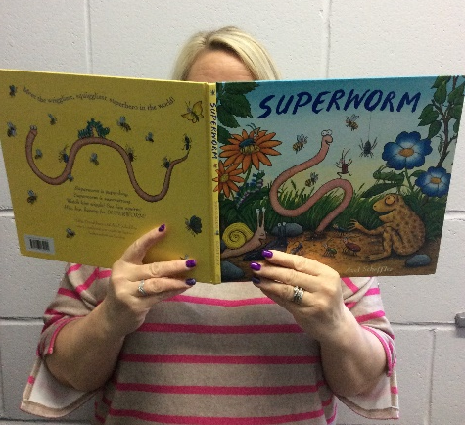
Mrs Massey

Slide 3
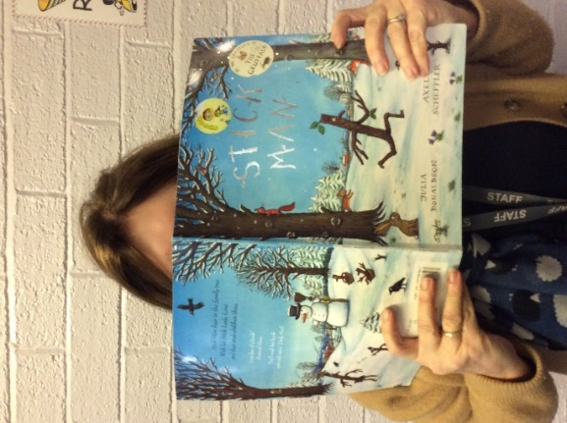
Mrs Finegan

Slide 4
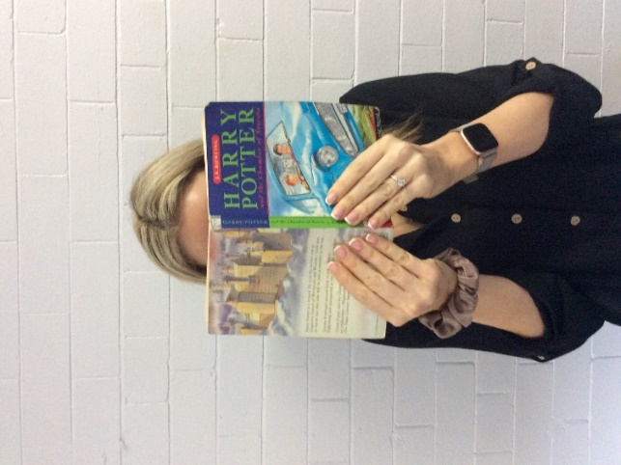
Miss Aulton

Slide 5
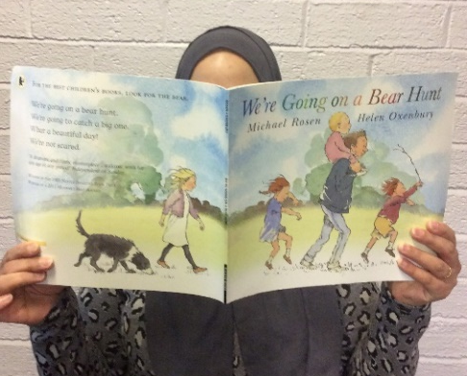
Mrs
Patel

Slide 6
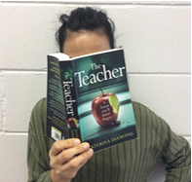
Miss Matlub

Slide 7
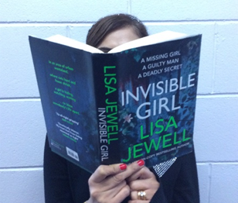
Miss Chaudhry

Slide 8
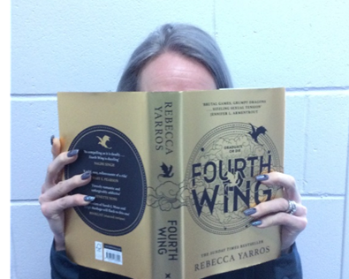
Mrs Taylor

Slide 9
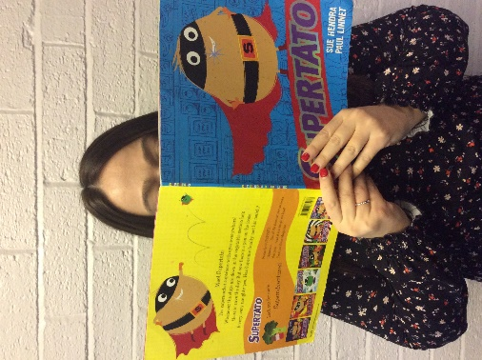
Miss Tudda

Slide 10
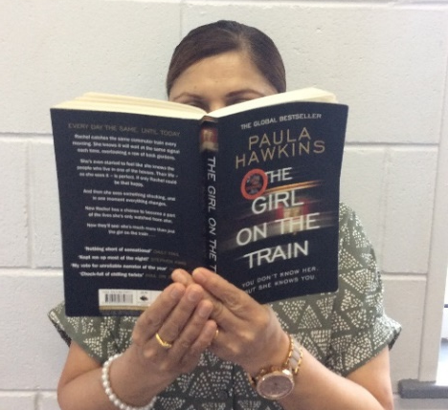
Mrs
Patel

Slide 11
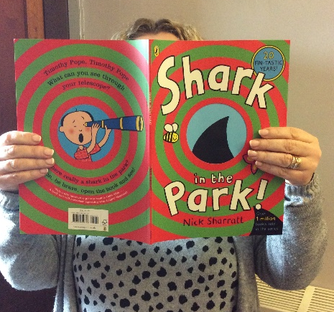
Mrs Eckersley

Slide 12
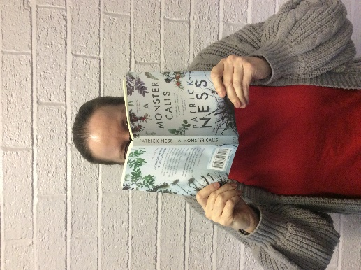
Miss Avis

Slide 13
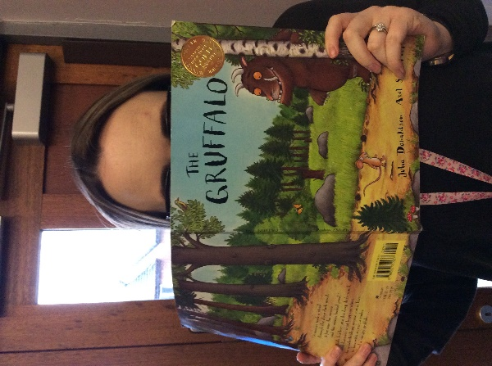
Mrs Whittle

Slide 14
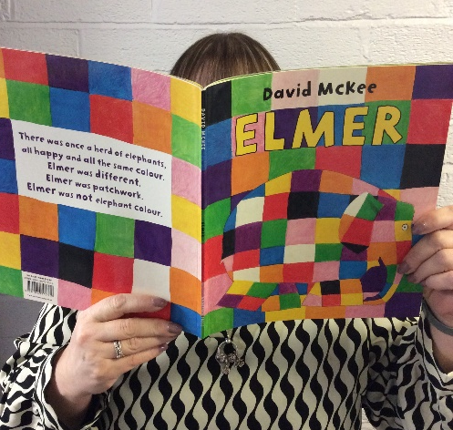
Mrs Nelson

Slide 15
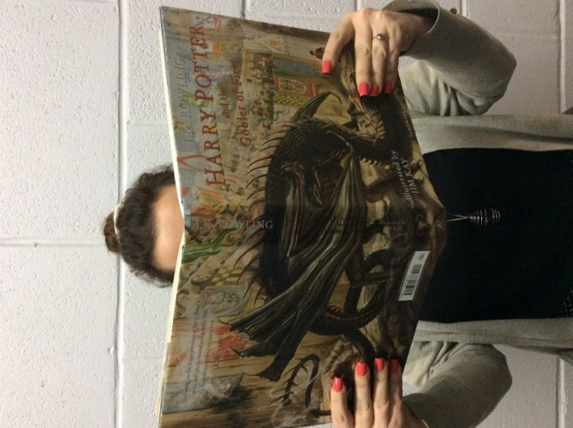
Miss Taylor

Slide 16
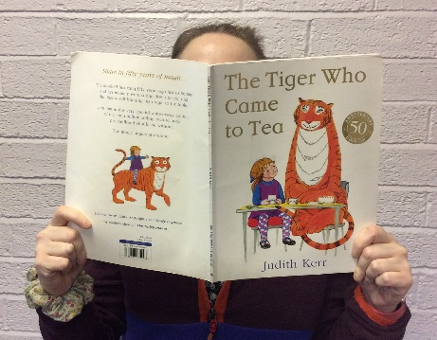
Mrs Brown

Slide 17
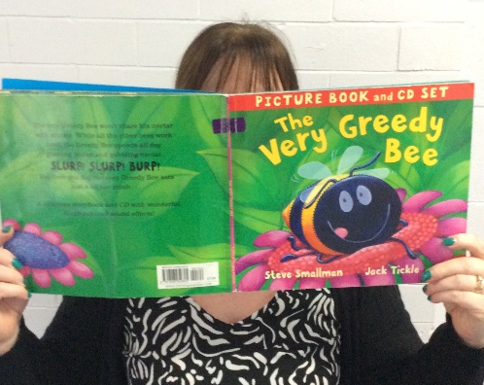
Mrs Grunshaw

