Slide 1
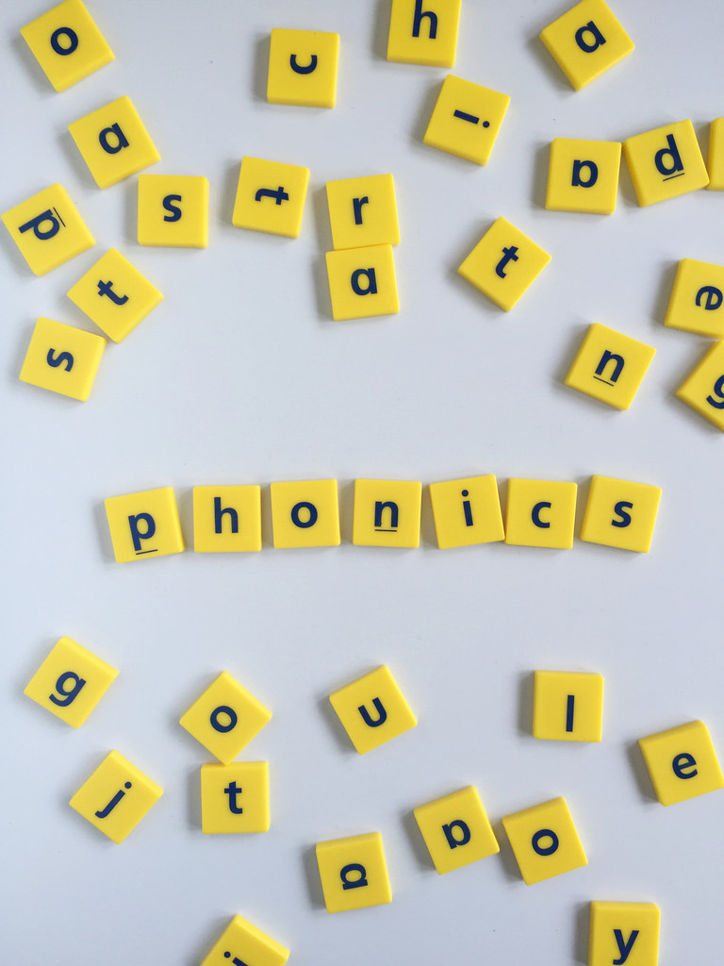
Phonics for parents
A guide to helping your child learn phonics

Slide 2
Why teach phonics?
The ability to read and write well is a vital skill for all children in order for them to have an enjoyable and successful school experience.
Phonics help the children to develop good reading, writing and spelling skills.
At school we use a scheme called ‘Red Rose Letters and Sounds’ which forms the basis for our teaching.

Slide 3
Why teach phonics?
Phonics, taught in a structured way, is generally accepted to be the most effective way to teach reading and writing.
Children learn to hear and recognise sounds in words and spell them correctly.
This assists with their confidence, accuracy and fluency.
Although we teach a daily phonics lesson, we do not teach phonics in isolation – children also need to learn other reading and comprehension skills alongside phonic knowledge.

Slide 4
Expectations in reading
This is the Early Learning Goal in Literacy which the children should achieve by the end of their year in Reception.
Comprehension
• Demonstrate understanding of what has been read to them by retelling stories and narratives using their own words and recently introduced vocabulary.
• Anticipate (where appropriate) key events in stories.
• Use and understand recently introduced vocabulary during discussions about stories, nonfiction, rhymes and poems and during role play.
Word Reading
• Say a sound for each letter in the alphabet and at least 10 digraphs.
• Read words consistent with their phonic knowledge by sound-blending.
• Read aloud simple sentences and books that are consistent with their phonic knowledge, including some common exception words.
Writing
• Write recognisable letters, most of which are correctly formed.
• Spell words by identifying sounds in them and representing the sounds with a letter or letters.
• Write simple phrases and sentences that can be read by others.

Slide 5


Did you know…?
The English language has…
26 letters
44 sounds
over 100 ways to spell those sounds
It is one of the most complex languages to learn to read and spell!

Slide 6
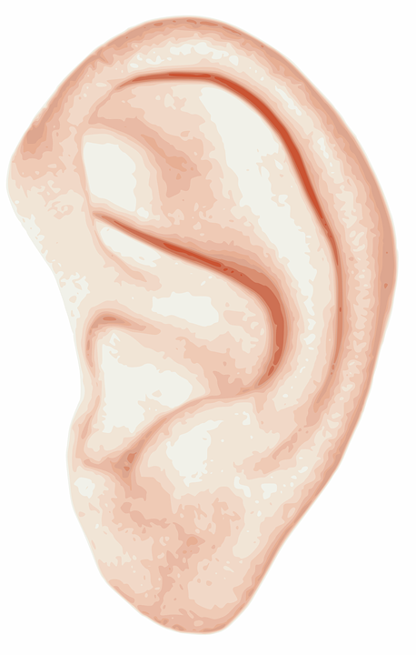

Some definitions!
CVC – Consonant Vowel Consonant (spelling pattern)
Phoneme – the smallest unit of sound in a word
Grapheme – the letters that represent the phoneme. The grapheme could be 1 letter, 2 letters or more!
You hear a phoneme
You see a grapheme

Slide 7
Phonics at a glance
Phonics is…
Skills of segmentation and blending
and
Knowledge of the alphabetic code

Slide 8
Phonics consists of…
Identifying sounds in spoken words
Recognising the common spelling of each phoneme (sound)
Blending phonemes into words for reading
Segmenting words into phonemes for spelling

Slide 9
How to say the sounds
Saying the sounds correctly with your child is extremely important
The way we say the sound may well be different from when you were at school!
We say the shortest form of the sounds
https://www.youtube.com/watch?v=V32pB2lposo

Slide 10
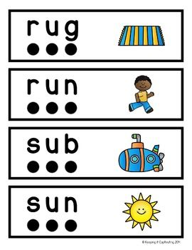
Blending
This is where we recognise the letter sounds in a written word and merge or ‘blend’ them in the order they are written to pronounce the word
We use our ‘blending hands’ to say each sound, bringing our hands together to say the word.
https://www.youtube.com/watch?v=3ovJIxTQpsU&t=55sc – u – p
d – ar – k
ch – ai – n

Slide 11

Segmenting
This is where we ‘chop up’ the word to spell it out – so we say each of the phonemes separately.
We use our ‘phoneme fingers’ to say each sound in the word.
It is the opposite of blending.
We identify the individual sounds in a spoken word
(eg h-i-m, s-t-or-k) and write down the letters for each sound to form the word ‘him’ and ‘stork’.

Slide 12
Tricky words
Some words are not phonically decodable (you can’t sound them out) – the children are not able to read them initially using the phonemes they have learned
Phase 2 – I no go to the into
Phase 3 – me be he she we are you they was all my her
Phase 4 – said have like so do come some little one were there out what when
Your child may bring home some tricky words in their reading bag – please help them learn to read them by sight.

Slide 13
How does the teaching of phonics progress over the reception year?
We start with phase 2 phonics – learning sounds which are represented by 1 letter (s, a, t, p, i, n…)
Some children may recap phase 1 which focuses on listening skills.
We move onto phase 3 – learning sounds which are represented by 2 letters (ai, ee, oa, ue, ar…), and by 3 letters (igh, ear, ure, air)
Towards the end of the year we progress onto phase 4 which recaps the phase 3 sounds but in greater depth (ccvc words – eg drop, clap; cvcc words – eg hand, nest; compound words eg – raincoat, popcorn)

Slide 14
Phase one
Phase 1 has seven aspects, with a focus on listening skills…
Tuning into sounds
Listening and remembering sounds
Talking about sounds – music & movement, rhythm & rhyme, sound effects, speaking & listening skills

Slide 15
Phase one
This phase covers 7 areas of listening skills:
Environmental sounds
Instrumental sounds
Body percussion
Rhythm and rhyme
Alliteration
Voice sounds
Oral blending and segmenting

Slide 16


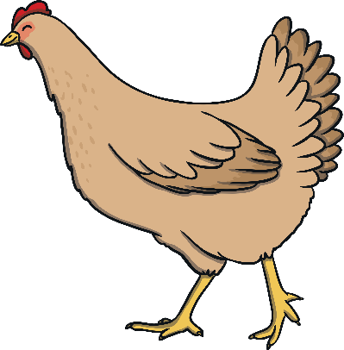







Find the rhymes!

Slide 17


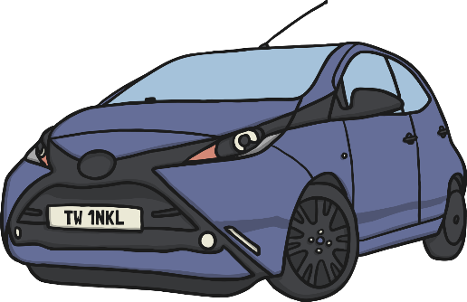





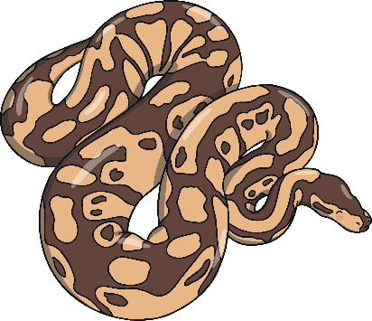
Find the starting sounds
Can you find three things beginning with ‘sss’?
How many things begin with ‘h’?
Notes:
Set 1: s, a, t, p
Set 2: i, n, m, d
Set 3: g, o, c, k
Set 4: ck, e, u, r
Set 5: h, b, f, ff, l, ll, ss
Phase 2 usually begins when children start their formal education in reception, though some preschools may also begin to teach letter sounds

Slide 18
Phase 2 Phonics Letters and Sounds aim to develop the following skills
Knowledge and understanding of at least 19 letters
Practising letter recognition for reading and recall for spelling
Practising oral blending and segmentation
Practising blending for reading VC (in, at, on) and CVC (cat, bin, web) words
VC and CVC words for spelling
Practising high-frequency common words
The 19 letters mentioned above are to be taught in 5 sets, with a set being taught over 1-2 weeks (we usually introduce 3 sounds a week). The sets are as follows:
Set 1 | s | a | t | p
Set 2 | i | n | m | d
Set 3 | g | o | c | k
Set 4 | ck | e | u | r
Set 5 | h | b | f, ff | l, ll | ss

Slide 19
Phase 3 activities are broken into broad groups (also including daily recap of phase 2 phonemes)
Teaching letter names
Practise blending for reading
Practise segmentation for spelling
Teach reading the tricky words
Practise reading and spelling words
Practise spelling two-syllable high-frequency words
Practise reading and writing captions and sentences

Slide 20
The letters and graphemes learned in phase 3 are as follows:
Sound | Example | Sound | Example
ch | chop | ar | arm
sh | ship | or | for
th | thick | ur | hurt
ng | sing | ow | now
ai | rain | oi | coin
ee | sheep | ear | near
igh | fight | air | hair
oa | boat | ure | pure
oo | look moon | er | digger
Set 6 | Set 7
j | y
v | z
w | zz
x | qu

Slide 21

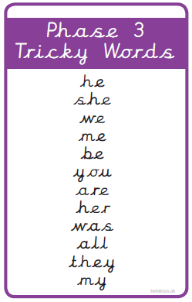
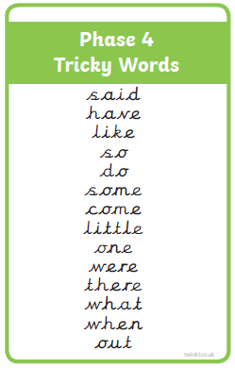

Slide 22
Now for the tricky bit!
Phonemes ( how it sounds) are represented by graphemes (how it looks).
A grapheme can consist of 1, 2 or more letters.
A phoneme can be represented/spelled in more than one way (c – cat, kennel, choir; oo – moon, book; ow – snow, now).
The same grapheme may represent more than one phoneme (me, met) – it looks the same but sounds different.

Slide 23
How can you help your child?
Sing an alphabet song together
Play ‘I spy’
Praise your child for trying to segment and blend words
Learn the tricky words
Play phonic games
Play pairs with words and pictures

Slide 24
Reading at home
Phonics is not the only thing needed to become a fluent and competent reader!
Please continue to read with your child daily and encourage them to…
Sound out the words
Re-read the sentence to check it makes sense
Use the pictures to look for clues
Ask questions about the book and encourage your child to make predictions
Visit the library
Most importantly, enjoy reading!

Slide 25
Reading at home
Sometimes it is difficult to hear your child read as we all live busy lives, but try to set aside 10 minutes each day to spend time sharing and reading their school book or a favourite book from home.
If your child doesn’t want to read, think about the environment around you. Is it a relaxed atmosphere? Are you or your child distracted by technology around you? This should be a precious time to enjoy and share books together.
Stay calm if your child is getting words wrong. Give them time to have a go but not too long, and say the word for them if they are struggling.

Slide 26
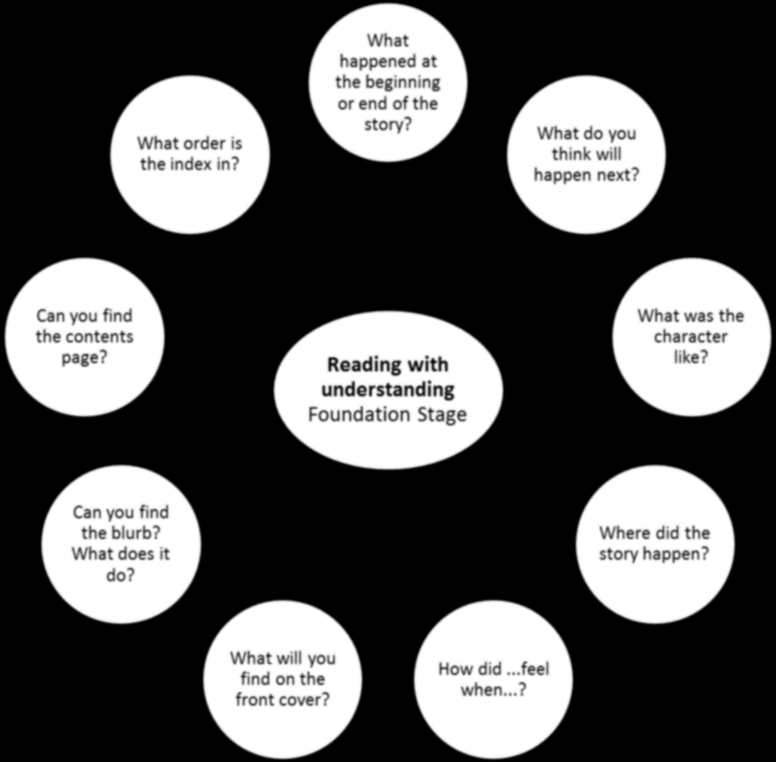
Here is a range of suggested questions for you to use when reading with your child at home to support reading with understanding and meaning. Please note that some of the questions are specific for non-fiction texts.

Slide 27
Resources
www.phonicsplay.com Lots of free games for each phase, especially good for reading non-words.
www.oxfordowl.co.uk/for-home Oxford Owls website
www.ictgames.com/literacy Wide range of games for sounds, words and rhyming.
www.topmarks.co.uk Search engine designed for school where you can find a wide range of resources and activities with a phonic focus.
YouTube clips:
Mr Thorne and Geraldine the Giraffe
Epic Phonics
Silly School Education phonics
Tricky Word songs Phase 2, 3, 4

